Slide 1
Observer webinar ​

Slide 2
What are we covering?
Delivering An Observed Session:
Resources
Planning and preparation​
Meet and greet the Associate​
Brief current guidance session​
Give the relevant guidance to achieve the ‘Aim’ of the session​
Debrief the current guidance session
Volunteer Dashboard
Road Safety Resources
Audience
Delivering An Observed Session:
No Q&A option or Chat
Don’t use the icons, specifically the hand raise option
Vehicle Technology & Advanced Driver Assistance Systems (ADAS)​
Hints and tips

Slide 3
Delivering an Observed Session ​

Slide 4
Planning and preparation​
Plan the guidance session to suit the Associate’s needs
Plan to meet and finish in a safe, public place with access to facilities
Devise a route that matches the time available and session objectives

Slide 5
Planning and preparation​
Base the guidance session around: ​
- course material​
- the competency sheets​
- the previous Development Plan​
This will help to identify the Associate’s specific needs​
You will have an agenda for the session, so will the Associate
Relate session to the type of vehicle

Slide 6
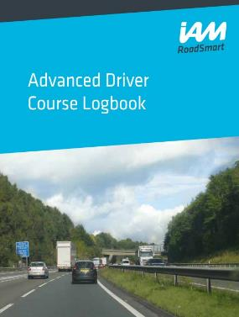
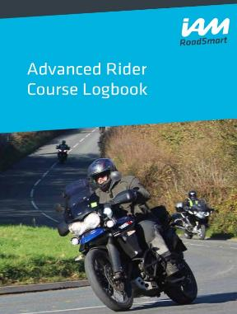
Planning and preparation​
Course material
Logbook is being reimagined as digital format option
New videos
New Advanced Driver and Rider Videos (Coming early summer 2024)
4 x brand new instructional videos featuring our members to complement the Advanced Course
Core Driving Skills
Core Riding Skills
Bends and Limit Points (Car)
Bends and Limit Points (Bike)
Associate’s Advanced Course Logbooks Reimagined
Plans in place to reimagine the Advanced Course Logbooks in a digital format to be accessible on mobiles, tablets and desktops

Slide 7
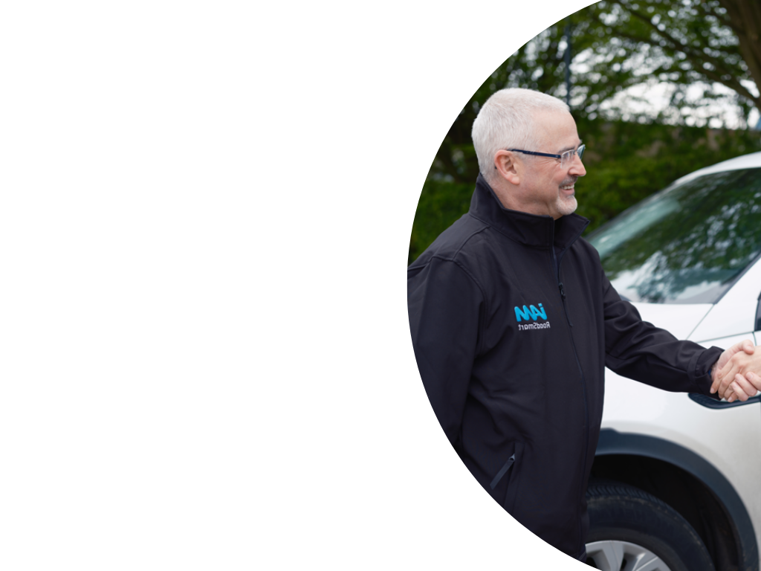
Meet and greet the Associate​
IAM Ambassador
Personal Standards ​
- IAM RoadSmart branded clothing​
- Clean, legal, roadworthy car/motorcycle ​
Always demonstrate an exemplary attitude to road safety​
​Demonstrate advanced driving techniques & practices ​
Customer-centred approach ​
Associate’s ‘personal space’ must be respected​​
IAM RoadSmart risk assessment for Observing​

Slide 8
Meet and greet the Associate​
Open, friendly but professional approach​
You need a plan with a short introduction about you​
Develop your own style, be flexible with your approach ​
First meeting - what is the Associates’ driving/riding history? ​
Eyesight
Document declaration
Legality
Vehicle
What are their motivations for completing the course?
Keep the session focussed, review the previous development plan
Make and use notes - tell the associate you are going to do so
Use an aide memoire if it helps

Slide 9
Brief current guidance session
Use the competency sheets to set clear aims and objectives for the session. Discuss them with the Associate, allow them to tell you what is working for them and what is not.​
Do not overload but remember specifics to relate back to the competency sheets.​
Be encouraging, there is always good in every drive or ride ​
Remember whilst encouraging a systematic approach, we are also encouraging a thinking approach
Effective questioning of the associate’s thought process will help promote the ‘Thinking’ driver or rider

Slide 10
Brief current guidance session
Remember to cover ​
- Estimated time for the session​
- Route direction​
- Stopping and loss of contact protocols ​
Verbal disclaimer BEFORE moving off​
Encourage associate to relax – engage them in conversation with open questions​
Ask the Associate if they have any questions & answer appropriately​

Slide 11
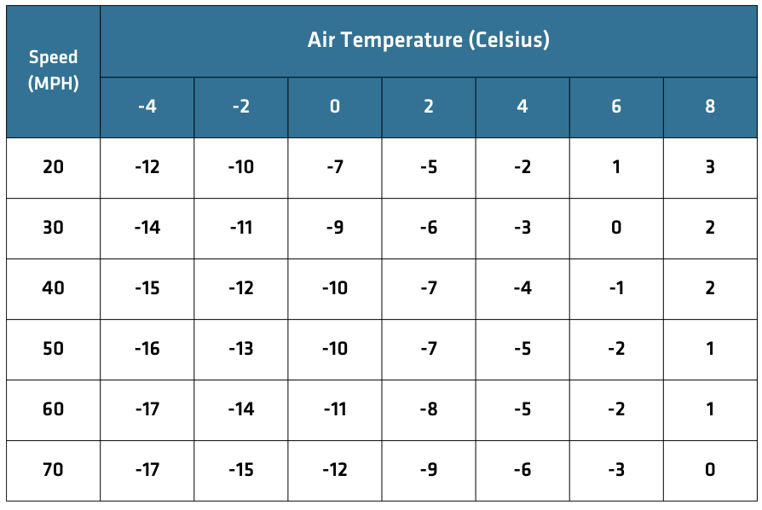
Brief current guidance session
Below freezing overnight and temperature not likely to exceed +5 degrees – consider rescheduling ride/drive. ​
As the observer, you make the decision.

Slide 12
Give the relevant guidance to achieve the ‘Aim’ of the session
Remain focussed at all times and stay alert​
Evaluate the Associate’s driving/riding and offer guidance as required​
Keep control over associate – safety is paramount, stop the drive/ride if required​
Start by observing the key elements, identify safety areas first​
Look for a pattern or theme to the drive/ride – summarise

Slide 13
Give the relevant guidance to achieve the ‘Aim’ of the session
Present new learning material in manageable step by step parts​
Demonstrate a flexible approach to learning throughout the session​
Avoid overloading the associate with instructions or guidance
Make effective use of ‘Open Questions like Who, What, Where, When, Why and How, e.g.​
- Where are you looking, why is that? ​
- What benefit is that giving you? What can you see ahead? ​
- Where are you going to position, why is that? ​
- What benefit will that give you? ​

Slide 14
Debrief the current guidance session​
Use the logbook​
Demonstrate your ability to involve the Associate as an equal​
Review the competency statements, involve the associate in the discussion​
If there are significant development areas – prioritise and work on the most pressing in the development plan​
-Must
-Should
-Could
Relate the debrief back to specific incidents
Compliment the Associate for effort and not just achievement
Use landmarks to help with your recall
You need to develop your recall and memory
Develop your own style, mnemonics can help

Slide 15
Debrief the current guidance session​
Listen carefully to what the Associate has to say​
Concentrate on the main issues and avoid overloading the Associate​
Create a development plan together with the Associate ​
Always finish on a positive note with encouragement to look forward to the next session​
Encourage the Associate to practice their driving skills between sessions
Be careful of your words on others

Slide 16
Test Ready ​
The book defines a score of 2 as Satisfactory or ‘Consistently Demonstrates the Competency’, in other words, Test Ready
Use the competency sheet to evidence both competency and consistency
Once is an incident, twice could be a coincidence, three times or more is demonstrating a pattern or a trend
Don't over train and don’t promise a F1RST

Slide 17
Useful Information​

Slide 18
Advanced Driver Assistance Systems (ADAS)
Encourage associate to understand the systems fitted to their vehicle
Remember driver/rider personal choice
Dash cam ​
Sat nav​
Digital speedos

Slide 19
Hints and Tips
IPSGA not IPGSA or “Double system” applications​
Speed of approach problems leading to rushed gear changes and decisions​
Regenerative braking is part of speed loss phase
Motorcyclists: front brake, rear brake or both – MC Roadcraft page 120​
Quick shifters​
Block changing​
Auto boxes / EV / DCT – still on the brakes as they enter the hazard and / or steering​
Time to react

Slide 20
For motorcycle observers… ​
Consider how you position to give you the best view of the associate’s use of machine controls ​
For example, look at their foot movement in relation to gears and brakes ​
Look for clues to identify system faults, for example no brake light showing when there is a clear reduction in speed. Are they using the gears to slow or simply riding in a low gear?​
In relation to your positioning, consider your following position, left or right of the rider and don’t’ get drawn in to their errors

Slide 21
For car observers…
You will need to be familiar with vehicle operating systems that differ from your own vehicle, for example, manual gear box v EV, automatics
If you drive an automatic remember how you drove a manual gear box, this will help you develop the associate’s system application​
Avoid distracting the driver, control the level of conversation in the car
Respect your driver's personal space ​
Concentrate, observe the associate, keep focussed

Slide 22
Your performance
Your riding/driving must be to the highest standard to enable you to identify developmental points with your associate ​
Quite simply, if you don’t get it right, how do you know if they are?​
Ask yourself ‘what would I be doing for this hazard?’ ​

Slide 23
Resources ​

Slide 24
Equality, Diversity and Inclusion ​
Demonstrate the RoadSmart Values and Behaviours
Uphold the reputation of IAM RoadSmart and set a positive example to others ​
Be courteous and respect other people’s views, interests, and uniqueness ​
Challenge inappropriate behaviour, discrimination and/or unfair treatment appropriately
Discuss any problems or issues in a reasonable and constructive manner ​
Ask for guidance and support when required ​
Be reliable and considerate to fellow volunteers​
Remember Safeguarding and Zero Tolerance

Slide 25
Social Media behaviours ​
Don’t be abusive, rude or any way hurtful towards others. This includes other contributors on this site, IAM RoadSmart staff and any other individual/organisation
Stay on topic. It is not a forum for individual grievances or personal concerns​
Please do not post inflammatory or aggressively negative comments about IAM RoadSmart or our content. We are happy for constructive debate to be had but reserve the right to edit, hide, or remove posts that we believe to be damaging to our reputation
Keep it civil and respectful. Do not use swear words or offensive language. We will immediately remove any comments we deem to be racist, sexist, or discriminatory towards any group of individuals
We will block any contributor that overtly or persistently goes against our group rules

Slide 26
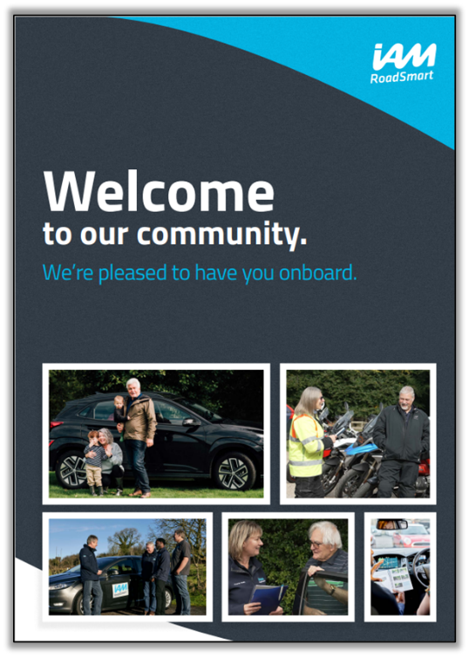
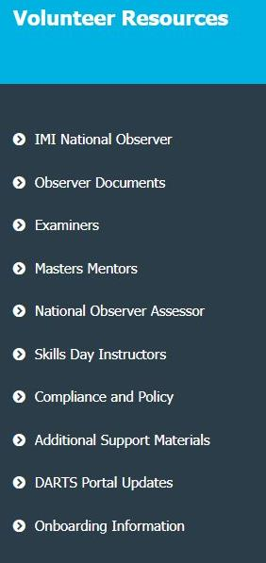
Where do I find Observer resources? ​
Headlight
Update My Profile
Run sheets on dashboard​
Road safety resources
Volunteer resources on the dashboard

Slide 27
Remember
​Reflect on guidance session and consider if the learning material could have been presented differently
Self-evaluate your own performance
If you have any questions, please ask your in-house experts:
-Chief Observer
-Training leads/managers

Slide 28
Thank you
​Thank you for attending our webinar and for your commitment, energy and enthusiasm for observing.

