Slide 1
Guidance on IAM RoadSmart Experiences: Highlands Goosechase

Slide 2
How do I get started?
Download the Goosechase app from the App Store or Google Play.
Create a free account and then search for IAM RoadSmart Experiences: Highlands Goosechase
Once you've found the challenge on the app, enter the code WYUKD2
Wait for the challenge to load, and then you're ready to begin! The challenge will be available from 19 May 2025 to the 31 October 2025.

Slide 3
How does the challenge work ?
Teams should consist of at least two people: driver and passenger/navigator.
The Highlands Goosechase is a challenge not a race.
The goal is to complete the missions and gain the maximum number of points.
The team that has solved the most missions and accrued the most points is the winning team. All questions are worth 10 points. The maximum number of points is 280. We recommend that you read through each clue in the mission order, while stationary in order carefully plan your route.

Slide 4
What rules do I need to remember ?
All traffic laws and parking regulations must be adhered to at all times.
Always drive and park safely. When driving, the driver and passengers must wear a seatbelt.
Only the passenger(s) may use the Goosechase app when driving in your vehicle.
Please take adequate rest stops/breaks during the event and have fun!

Slide 5
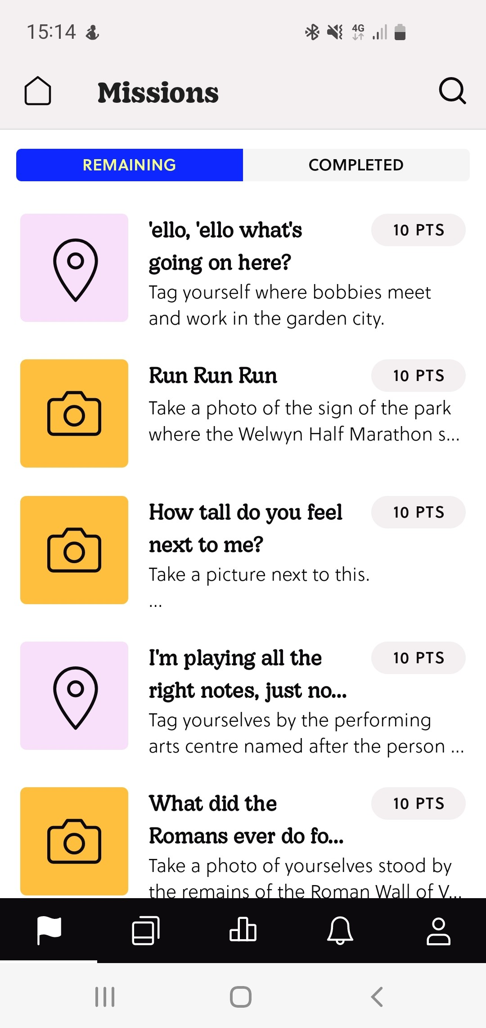
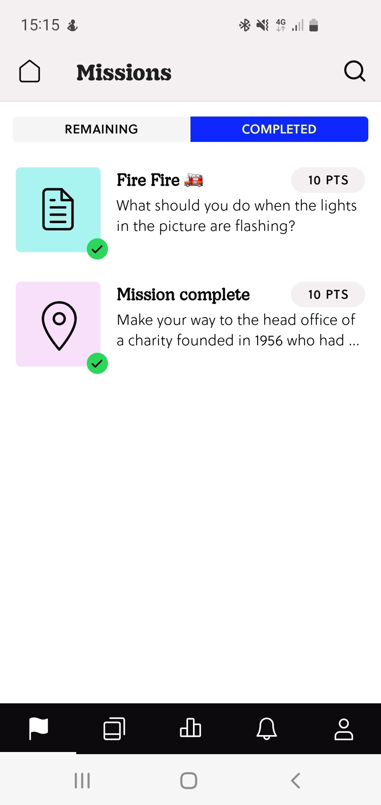
How do I use the Goosechase app ?
Remaining
On the app, you will see the remaining missions that you still need to complete.
Completed
On the app, you will see the missions that you have completed, marked with a green tick.

Slide 6
What are types of missions ?
There are three types of missions:
(1) Submit a photo or video
(2) Tag yourselves in a location using GPS
(3) Question and Answer
Please note, some missions will be automatically marked by Goosechase. Points will be awarded automatically.
However, other missions (like the photo mission) will be marked after the challenge is complete. Points will be awarded to teams after a review of your answers.

Slide 7
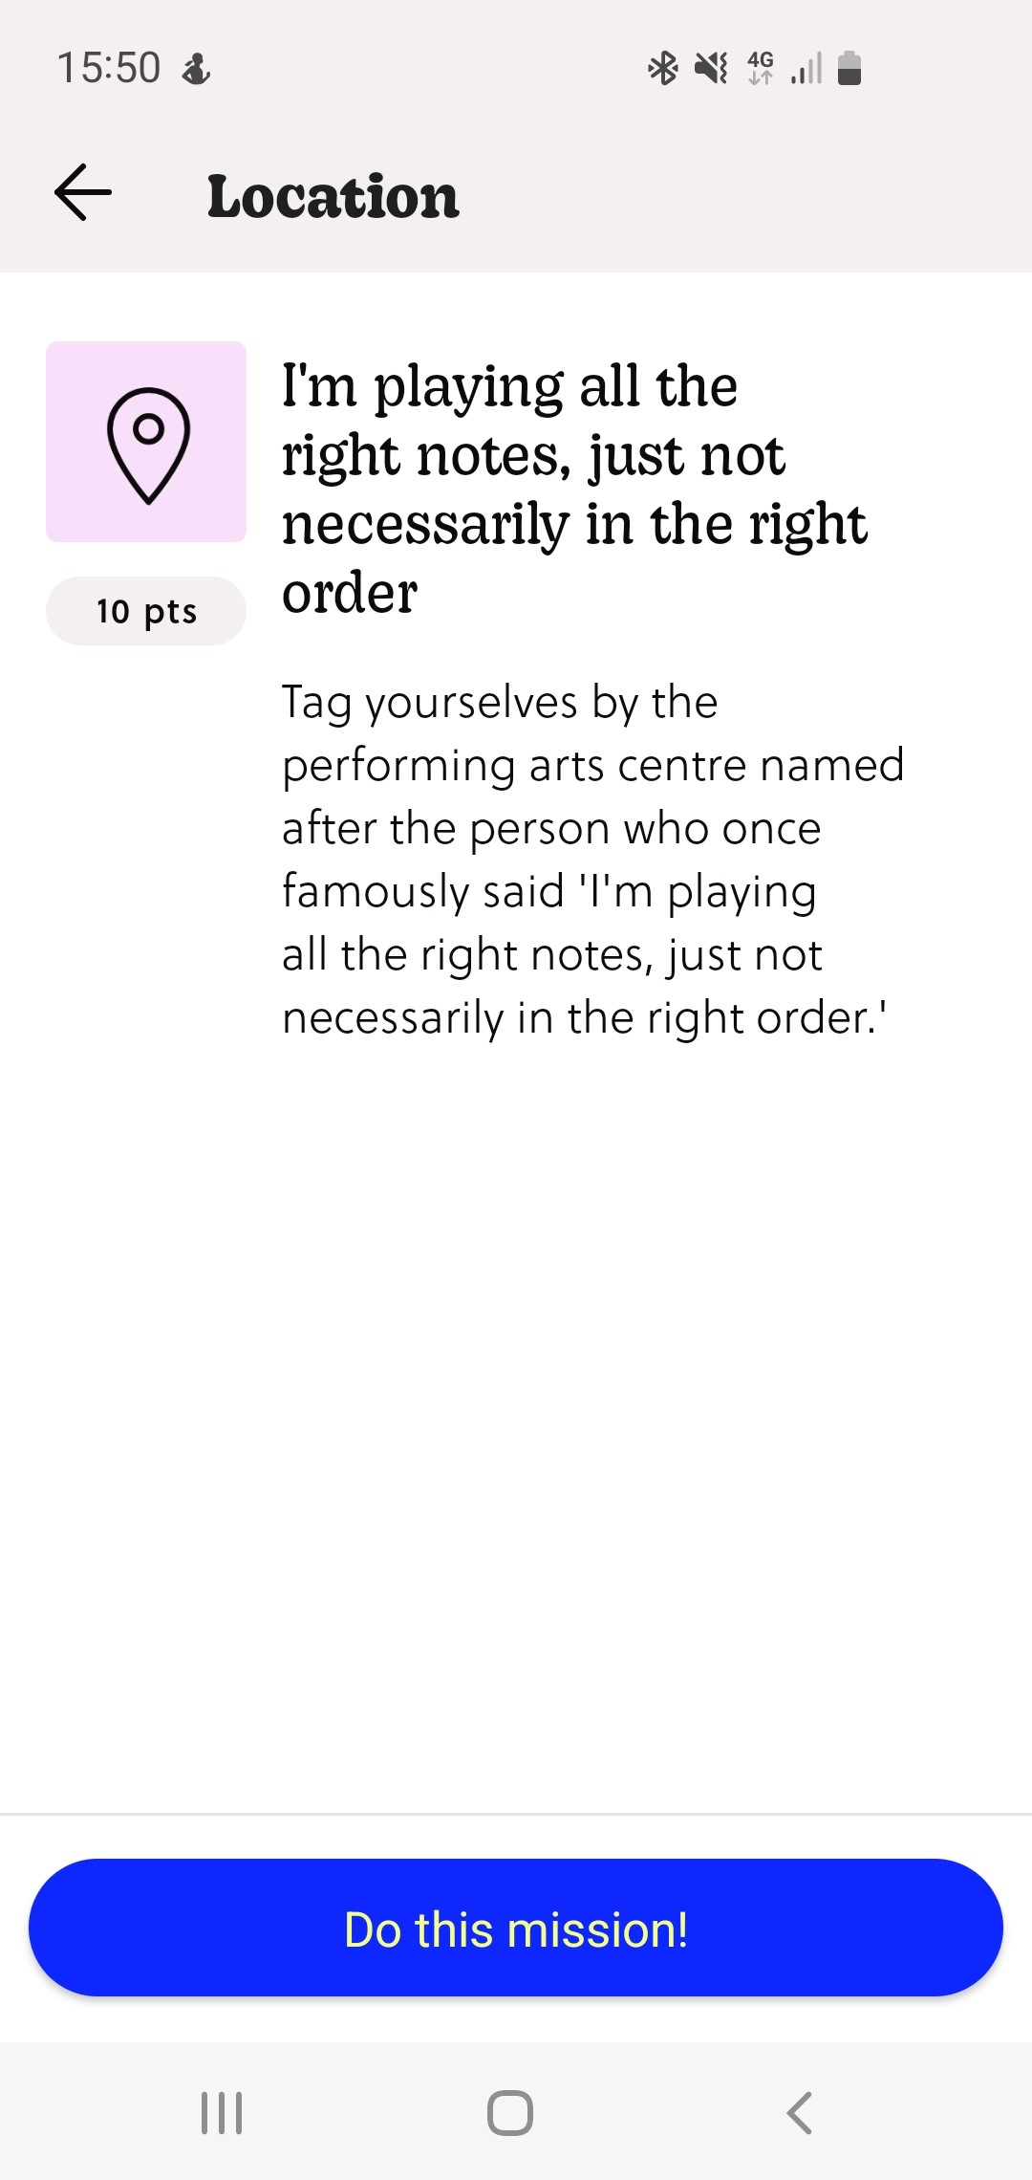
What is a Location mission ?
For a location mission, read and work out the answer.
Once you've solved it, drive to the correct location.
Park safely, and walk to the location.
Tag yourselves in the location via the app. The app will accept answers in a radius of 250 metres from the correct answer.

Slide 8
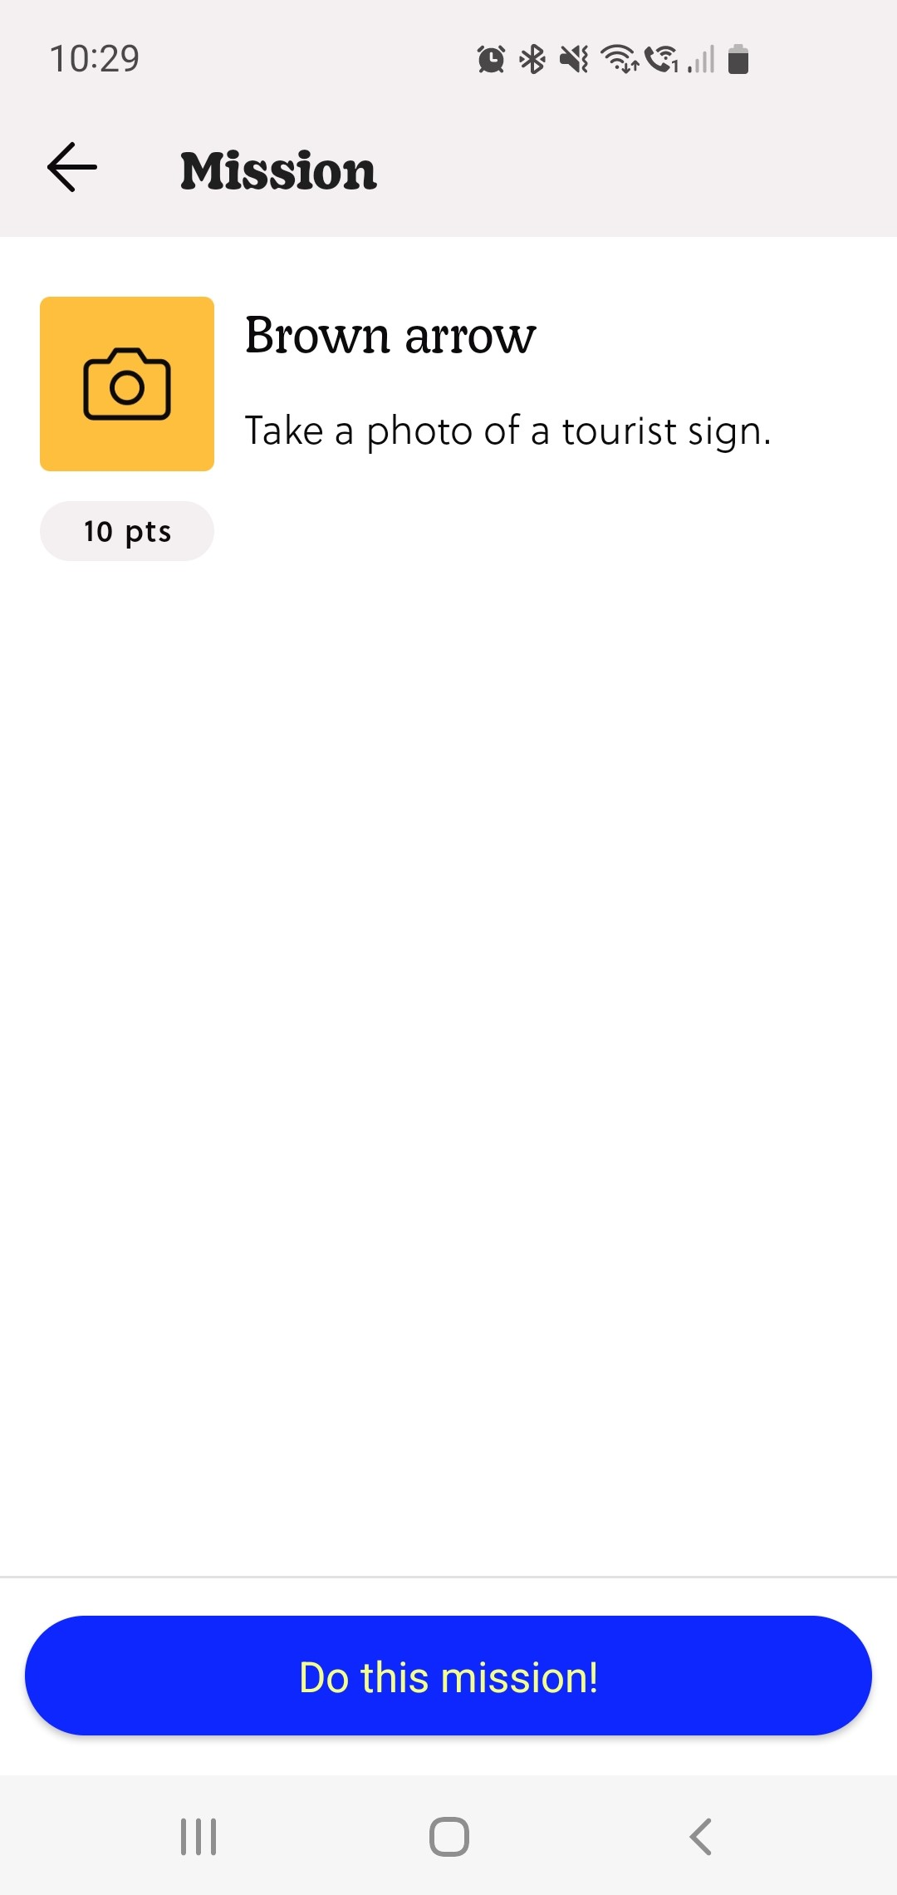
What is a Photo mission ?
For a photo mission, read and work out the answer.
Once you've solved it, drive to the correct location.
Park safely, and walk to the location.
Take a photo and submit via the app. You can also submit a short video capture instead.

Slide 9
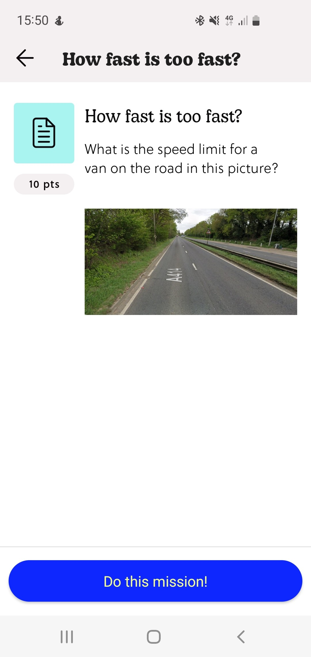
What is a Question mission ?
For question & answer missions, read through the clue.
Work out the correct answer and submit via the app.
Take care of your spelling before you submit.
Remember to be careful of typos as it can be case sensitive.

Slide 10
Do I need to prepare my vehicle ?
Yes. Before starting the challenge, your car must meet the vehicle eligibility requirements.
As the driver, you must have a valid driving licence for the class of your vehicle.
Your vehicle must be properly maintained and has a current MOT certificate, if required.
Ensure that your vehicle is insured for the event.

Slide 11
Do I need to prepare for the day?
Yes. Before starting the challenge, conduct vehicle safety checks: lights, fluid levels, tyres
Start the challenge with a full tank of fuel or enough for 100 miles.
Ensure you bring any glasses or sunglasses that may be required.
Bring your team's smartphone with the Goosechase app. Ensure you have data roaming switched on, your phone is fully charged and turn on your GPS to ensure it is accurately calibrated. You may want to bring an in-car charger or battery pack.

Slide 12
Are there any other useful tips ?
Yes. Ensure your sound is switched on to aid navigation.
Turn off predictive text to ensure you type the correct answer.
Once you start the missions on the app, you will not be able to restart at the beginning.
When using the Goosechase app, your progress will always be saved including if you pause or close the app. It will remember where you are, and will restart from the last instruction.

