Slide 1
GDPR Webinar 05 March 2024
Notes:
The volume and importance of personal data is ever increasing in the way that we as individuals accumulate, store, and share this. Our clients and customers entrust us to manage their data in the right way. The media frequently covers data breaches of personal information or warn about the extent of control over personal information.
At IAM RoadSmart, we care about our clients and customers personal data and it’s important that as an organisation we understand the basic rules around data protection and the steps we need to take to handle personal data in accordance with legislation. Each and every one of us plays an important role in achieving this.
Individuals are increasingly worried about their privacy and organisations of all types, whether large corporations, small businesses, charities or public bodies are coming more and more aware that data protection isn’t just a legal requirement but a social responsibility.

Slide 2
Introduction
The purpose of this session is to give you a basic understanding of Data Protection as well as to acquaint you with essentials of Data Protection requirements in your group and increase your awareness and confidence in handling personal data.
In addition to this, you will also gain:
an awareness of your own group's compliance with GDPR.
an understanding of the most utilised rights of individuals.
recognition of the consequences of not complying with GDPR.
an understanding of the ICO and how your group may interact with them.
an understanding of data breaches, including reporting breaches and better protecting your group from future breaches.
an understanding of the Freedom of Information Act.
Notes:
The purpose of this session is to give you a basic understanding of Data Protection as well as to acquaint you with essentials of Data Protection requirements in your group and increase your awareness and confidence in handling personal data.
In addition to this, you will also gain:
an awareness of your own group's compliance with GDPR.
an understanding of the most utilised rights of individuals.
recognition of the consequences of not complying with GDPR.
an understanding of the ICO and how your group may interact with them.
an understanding of data breaches, including reporting breaches and better protecting your group from future breaches.
an understanding of the Freedom of Information Act.

Slide 3
Contents
Introduction
What is GDPR?
ICO
- Who are they?
- ICO Registration
- ICO Complaints
What is personal data?
Data Handling Procedures
Data Protection Impact Assessments (DPIA)
Rights of Individuals
- Right to Access
- Right to rectification
- Right to erasure
- Right to data portability
Data Breaches
- What is a Data Breach?
- Why are they bad?
- Common Reasons they occur?
- What actions do we take when a data breach occurs?
- Who do you inform about the breach?
Security Measures
- Password protection
Freedom of Information
What We Expect of You
What Next
Quiz

Slide 4
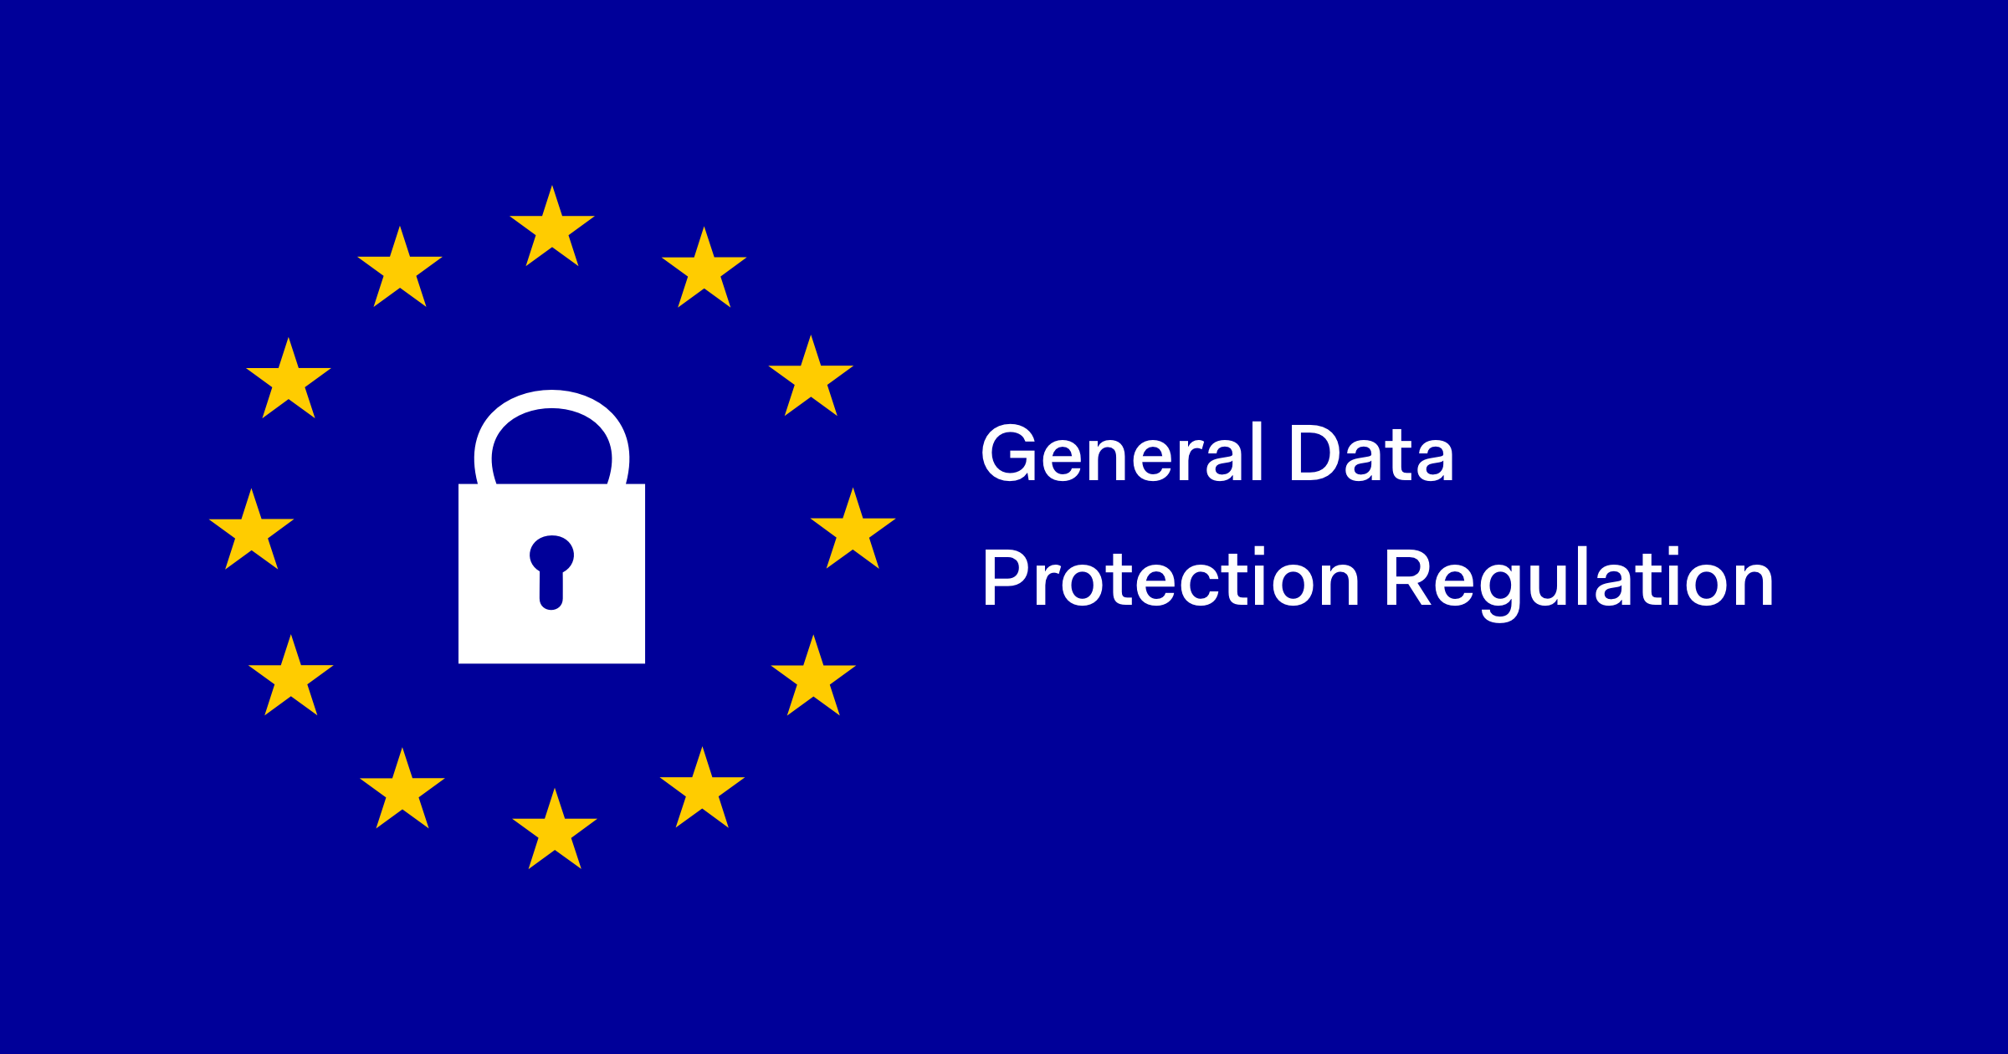
What is GDPR?
GDPR stands for General Data Protection Regulation.
It is a regulation enacted by the EU in 2018.
Applies to individuals within the EU and EEA (European Economic Area).
Data Protection is about making sure that you are being fair and responsible when it comes to processing people's personal data.
Notes:
GDPR stands for General Data Protection Regulation.
GDPR was designed to protect the privacy and rights of individuals whose personal data is processed, and it imposes responsibilities on organisations to handle such data responsibly and transparently. It is about making sure that you are being fair and responsible when it comes to processing people's personal data.
It is a regulation enacted by the EU in 2018.
Applies to individuals within the EU and EEA (European Economic Area
The EEA includes EU countries and also Iceland, Liechtenstein and Norway.
Data Protection is about making sure that you are being fair and responsible when it comes to processing people's personal data.

Slide 5
Information Commissioners Office (ICO)
Who are they?
ICO registration
How to register: https://ico.org.uk/for-organisations/data-protection-fee/register/
ICO Complaints
Notes:
ICO
Who are they? The ICO are an independent authority in the UK that promotes and enforces data protection laws. Its primary responsibility is to uphold information’s rights, including the implementation and enforcement of the general data protection regulations and the data protection act 2018.
ICO registration – Organisations that process personal data are generally required to register with the Information Commissioners Office (ICO) in the UK. This registration is a legal obligation under the Data Protection Act 2018. And General Data Protection Regulation.
Who should register? Data controllers, which are organisations or individuals that determine the purposes and means of processing personal data, are typically required to register with the ICO.
How to register: Organisations can register online at the ICOs website. The link is on the last slide. This registration must be renewed annually.
Consequences of non-compliance: It is essential for organisations to fulfil this obligation to demonstrate their commitment to data protection and privacy compliance. Failure to register with the ICO when require can result in penalties.
ICO Complaints
From time to time an individual may submit a complaint to the ICO stating they believe you have not acted lawfully and sufficiently to a data protection request from them. Example: for a Subject Access Request, they may believe you may hold more data on them than you do. Such as telephone conversations, teams’ calls, discussions in meetings. These complaints must be dealt with efficiently. The ICO are a very helpful throughout the complaint process and it is very much a process of explaining why you do not hold the data requested. Alternatively, you can receive a complaint if you have not dealt with a Data Subject Request within the statutory timeframe. In this situation the ICO are looking to see that you are improving your processes to ensure it does not happen again. We will be covering Data Subject Requests later in this webinar.

Slide 6
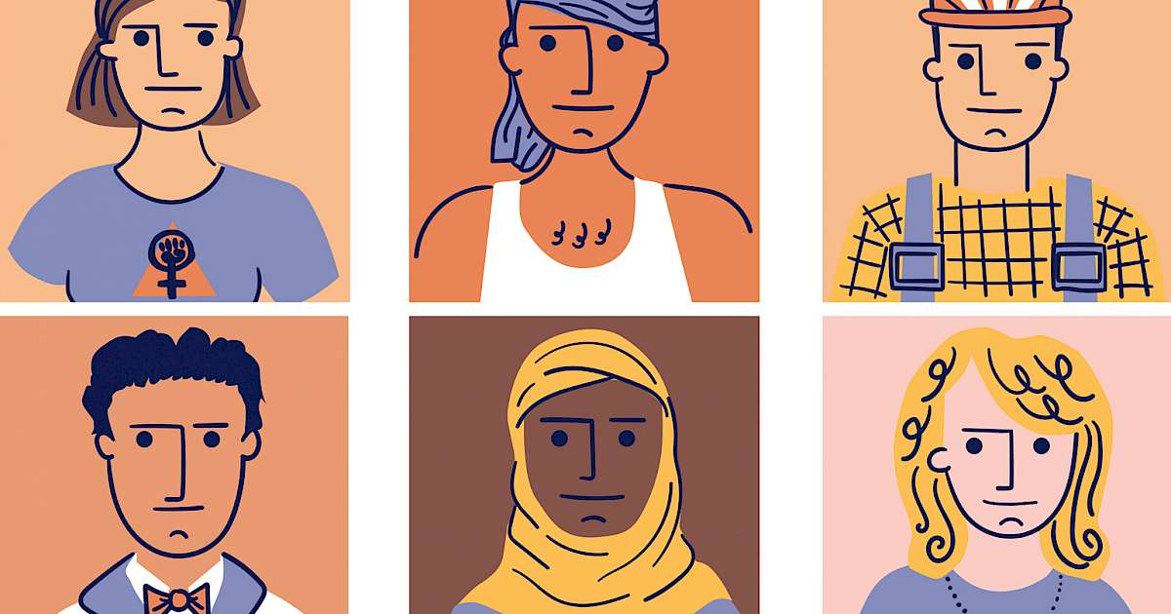
What is personal data?
Personal data is information that relates to an individual.
Activity
Can you name some examples of Personal Data?
Identification Numbers
Physical characteristics
Family information
Education records
Employment history
Membership details
Online activity
Usernames and Passwords
Notes:
Identification Numbers – National Insurance number, driving licence, passport numbers.
Physical characteristics – photographs
Family information – names, marital status.
Education records – degrees obtained and academic performance.
Employment history – previous employers, job roles.
Membership details – membership numbers, group subscriptions.
Online activity – IP addresses, cookies, and browsing history when tied to an identifiable individual.
Usernames and passwords – any log in credentials or security details associated with an individual.

Slide 7
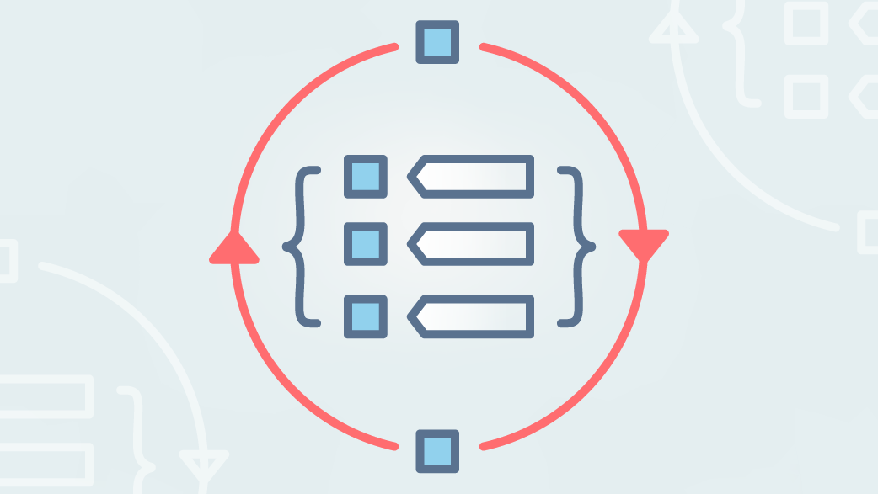
Terms
‘Data Subject’
A data subject is a person. It is an identifiable living individual to who personal data relates to.
‘Data Processing’
This is simply a call-all term to describe all things that could be done to personal data. Such as; collecting, recording, organising, storing, using, handling, deleting or archiving, etc.
Examples of Data Processing
Collecting names and address of people interested in hearing more about your group
Recording videos of group ride outs
Storing records for safeguarding data
Maintaining information in an associate log/file
Sending information to a personal email address of a member about a social event
Notes:
Now let’s define 2 important terms which are used frequently in data protection
Data Subject
A data subject is a person. It is an identifiable living individual to who personal data relates to.
Processing
This is simply a call-all term to describe all things that could be done to personal data. Such as; collecting, recording, organising, storing, using, handling, deleting or archiving, etc.
Examples of Data Processing
Collecting names and address of people interested in hearing more about your group.
Recording videos of group ride outs.
Storing records for safeguarding data
Maintaining information in an associate log/file
Sending information to a personal email address of a member about a social event.
In short, doing almost anything with personal data can be described as ‘processing’.

Slide 8
Appropriate use of Personal Data
Being lawful
The Data Protection Act 2018 is the main law in the UK, and we have also mentioned of the General Data Protection Regulation (GDPR).
In practice, handling personal data in an appropriate manner generally means:
Being open and transparent about how people’s data is processed and why it’s needed.
Processing the minimum amount of personal data necessary to fulfil the purpose for which it was collected.
Ensuring that appropriate security and controls are in place to prevent that data being mishandled.
Taking responsibility for data that belongs to other people and safeguarding it whilst it is under your control.
Building trust between your organisation and the people whose data is processed.
Recognising that people have a right to control their personal data whilst striking a balance with the needs of your organisation and wider society.
Notes:
Appropriate use of Personal Data
We have already said that organisations have a responsibility to process personal data in an appropriate manner, but what do we mean by ‘appropriate’?
Being lawful
The Data Protection Act 2018 is the main law in the UK and we have also mentioned of the General Data Protection Regulation (GDPR). This is a European Union law which, following Brexit, has been fully transposed into UK law as the UK GDPR. The laws set out the main obligations for organisations in the UK. In addition to this, you must ensure that you satisfy your own standards, policies, and procedures. Your group may cover things like how you obtain personal data, where it is stored and who has access to it.
In practice, handling personal data in an appropriate manner generally means:
Being open and transparent about how people’s data is processed and why it’s needed.
Processing the minimum amount of personal data necessary to fulfil the purpose for which it was collected.
Ensuring that appropriate security and controls are in place to prevent that data being mishandled.
Taking responsibility for data that belongs to other people and safeguarding it whilst it is under your control.
Building trust between your organisation and the people whose data is processed.
Recognising that people have ta right to control their personal data whilst striking a balance with the needs of your organisation and wider society.

Slide 9
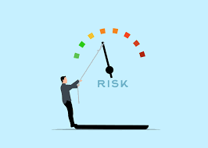
Risks and Challenges – Data Privacy in practice
Activity – Can you name any Risks of Non-Compliance with GDPR?
Reputation Damage
Financial Costs
Laws and Regulatory Action
Down time and loss of productivity
Notes:
Risks and Challenges – Data Privacy in practice
Now let’s consider some of the practical concerns that may be important for your group.
Activity – Can you name any Risks of Non-Compliance with GDPR? 30 seconds.
Reputation Damage
Reputational damage is a serious risk because we are expected to look after an individual’s data in an ethical and responsible way.
Financial Costs
Cyber-attacks, accidental disclosures and data breaches can lead directly to financial losses. These include the administrative time and operational costs needed to respond, repair and restore services that have been attacked or breached. There are also indirect financial effects such as the cost of the reputational damage such as loss of members.
Laws and Regulatory Action
There can also be fines and penalties for data breaches or unlawful processing imposed by data protection regulators or law courts. In the UK, the maximum fine for severe violations can reach £17.5million or 4% of the total global turnover, whichever is higher.
Down time and loss of productivity
Some breaches can result in an organisation having to decrease or halt production/services whilst errors are rectified which will inevitably result in a loss of income.

Slide 10
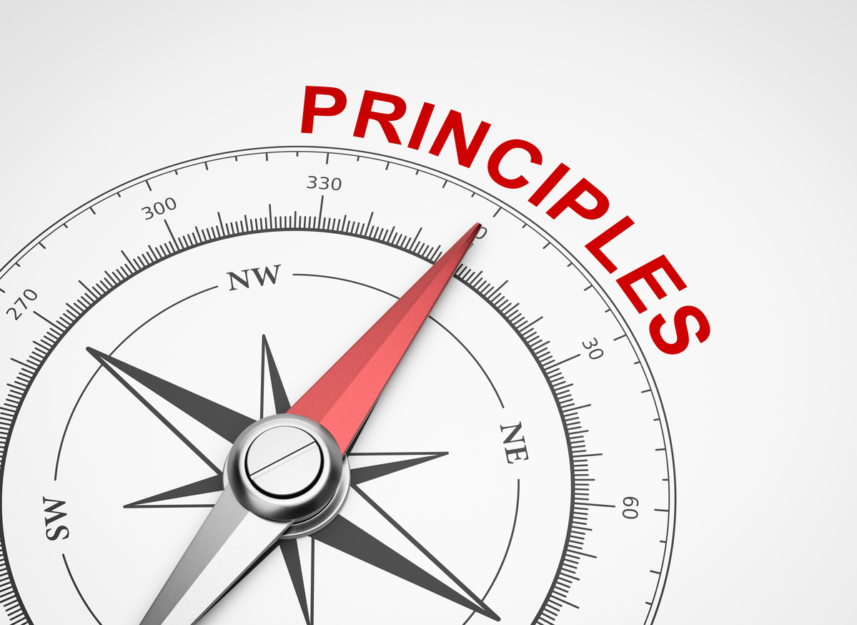
UK GDPR Principles
Data protection law aims to change the way we think about personal data.
There are 7 key principles which are central to the GDPR.
Lawfulness, Fairness and Transparency
Purpose Limitation
Data Minimisation
Accuracy
Storage Limitation
Integrity and Confidentiality
Accountability
Notes:
Data protection law aims to change the way we think about personal data.
The primary principles intend to teach us to value our privacy, and the importance of our data through giving us the tools that we need better control who can see our data and how they use it.
UK GDPR Principles
There are 7 key principles which are central to the GDPR. They are fundamental elements for data protection and organisations must ensure that any processing of personal data meets the expectations set out in them. Let’s take a look at the 7 principles:
Lawfulness, Fairness and Transparency – Personal data must be collected legally and processed in a way that is reasonable, clear, and honest.
Purpose Limitation – Personal data must be collected only for specified, legitimate purposes and not processed for a different purpose.
Data Minimisation – This includes ensuring that only the minimal amount of personal data is processed to achieve the organisations’ purpose.
Accuracy – Personal data must be accurate and kept up to date.
Storage Limitation – Personal data must not be kept for longer than is necessary.
Integrity and Confidentiality – The security of personal data must be maintained to minimise the risk of loss, destruction or damage.
Accountability – This includes taking responsibility for how personal data is process and ensuring that compliance can be demonstrated.
These are general principles rather than specific rules. For example, ‘storage limitation’ means you can only store data for as long as it is needed but the GDPR doesn’t specify how long that should be.

Slide 11
Lawful basis
Notes:
Whenever you collecting, handling, and storing people’s personal data personal information, you are required to have a lawful basis for doing so. The GDPR sets out six lawful bases for processing personal data, which are
Consent
You may provide consent to receive marketing materials from a group or policy updates from IAM RoadSmart
Performance of a Contract
You may need to obtain a associates telephone number to organise a training
Legitimate Interest
Next of kin, we do not need their consent to obtain their information from you as there is a legitimate interest.

Slide 12
Lawful basis continued…
Notes:
Vital Interests
A member of staff has experienced a severe, life-threatening allergic reaction at work and has fallen unconscious. Their employer calls for an ambulance and provides details of the employee’s health information to the ambulance crew. The disclosure is necessary in order to protect their vital interests.
Legal Requirement
Is where the processing is necessary for you to comply with the law – For example sharing salary data with HMRC.
Public Interest
A government agency has statutory powers to conduct research about the online shopping habits of consumers. The agency asks retailers to share the personal data of a random sample of their customers to enable it to carry out this function. It explains that it will process the data under ‘public task’ once it receives the information.

Slide 13
The practical application of GDPR.
There is much more to data protection law than these four, but they are important aspects to get right in a compliance programme.
Record of Processing
Data Protection Impact Assessments (DPIA)
Data Subject Rights (DSRs)
Data Breaches
Notes:
The practical application of GDPR.
There is much more to data protection law than these four, but they are important aspects to get right in a compliance programme.
Record of Processing
Data Protection Impact Assessments (DPIA)
Data Breaches
Data Subject Rights (DSRs)

Slide 14
Record of Processing
One of the specific requirements in the UK GDPR is the Record of Processing.
The Record of Processing identifies, among other things, the following key aspects:
The process or system where personal data is processed.
Whose personal data is involved.
What kind of personal data is processed.
The purpose for processing the personal data with whom is the data shared.
How long the personal data is retained.
What security measures are in place to protect personal data.
Notes:
Record of Processing
One of the specific requirements in the UK GDPR is the Record of Processing.
This is an internal inventory or listing of all the processing that takes place in your group. It involves identifying all the applications, systems, and process that process personal data.
The Record of Processing identifies, among other things, the following key aspects:
The process or system where personal data is processed.
Whose personal data is involved.
What kind of personal data is processed.
The purpose for processing the personal data with whom is the data shared.
How long the personal data is retained.
What security measures are in place to protect personal data.
A comprehensive Record of Processing will enable your group to understand where and how personal data is processed. It will also enable you to undertake another requirement under UK data protection law: a Data Protection impact Assessment.

Slide 15
Data Protection Impact Assessments (DPIA)
A DPIA should follow a standard process that includes, among other elements, the following:
Scope
Data Mapping
Risk Assessment
Mitigation Measurement
Documentation
Reviews
Notes:
Data Protection Impact Assessments (DPIA)
A DPIA is essentially a risk assessment. It is a requirement under the UK GDPR if the processing is likely to result in a high risk to individual rights and freedoms. A DPIA should follow a standard process that includes, among other elements, the following:
- Scope
- Data Mapping
- Risk Assessment
- Mitigation Measurement
- Documentation
- Reviews
There are not many occasions where a Road Safety charity would undertake a Data Protection Impact Assessment so we won’t do a deep dive into the process today but an ICO link to further information will be shared at the end.
The only situations I can currently foresee a DPIA being required is where any financial or medical information regarding members and volunteers are obtained and processed.

Slide 16
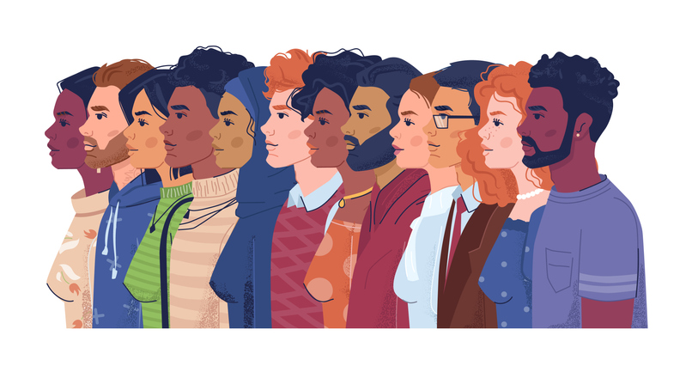
Rights of Individuals
Individuals have the right to be informed about the collection and use of their personal data. This is a key transparency requirement under the UK GDPR.
Requests to utilise these rights do not have to be explicit, they can be loose.
Right to Access
Right to rectification
Right to erasure
Right to data portability
Notes:
Rights of Individuals
Individuals have the right to be informed about the collection and use of their personal data. This is a key transparency requirement under the UK GDPR.
Requests to utilise these rights do not have to be explicit, they can be loose.
Right to Access
Where the individual is requesting to receive a copy of their personal data, and other supplementary information. Organisations are obligated to provide the requested information within one month, free of charge. Process: Acknowledge the request and request proof of identity from the individual. Compare the information on the proof given with the personal data hold on the individual. Once the identity has been confirmed you must perform a search of your system to collate all of the information you have found that contains their personal data. Remember data can be found within spreadsheets, emails and records. You must retract any personal data relating to another individual or that can be used to identify another individual.
Right to rectification
This right allows individuals to correct inaccurate or incomplete personal data held by organisations. The right to rectification is closely linked to the accuracy principle and gives individuals the right to have their personal data changed if it is inaccurate. Even if the data was correct when it was obtained, there is an obligation to reconsider its accuracy if asked.
Right to erasure
Also known as the ‘right to be forgotten’ grants an individual the ability to request the deletion of their personal data held by organisations. This right can be exercised under specific circumstances such as when the data is no longer necessary for the original purpose it was obtained for, or if an individual withdraws consent. Organisations must comply with such requests unless there are legal grounds for retaining the data. The right to erasure only applies to data held at the time the request is received and not any data obtained in the future. This right is not absolute and only applies in certain circumstances.
Right to data portability
This right allows individuals to obtain and transfer their personal data between different services. Individuals can request a copy of their data in a commonly used and machine-readable format.

Slide 17
Data Breaches
The ICO define a personal data breach as….’a breach of security leading to the accidental or unlawful destruction, loss, alteration, unauthorised disclosure of, or access to, personal data. This includes breaches that are the result of both accidental and deliberate causes. It also means that a breach is more than just about losing personal data.’
Data breaches can include:
access by an unauthorised third party.
deliberate or accidental action (or inaction) by a controller or processor.
sending personal data to an incorrect recipient.
computing devices containing personal data being lost or stolen.
alteration of personal data without permission.
loss of availability of personal data.
Notes:
Data Breaches
What is a Data Breach?
The ICO define a personal data breach as….’a breach of security leading to the accidental or unlawful destruction, loss, alteration, unauthorised disclosure of, or access to, personal data. This includes breaches that are the result of both accidental and deliberate causes. It also means that a breach is more than just about losing personal data.’
Please note that this definition includes both accidental and deliberate causes.
For example, personal data breaches can include:
access by an unauthorised third party.
deliberate or accidental action (or inaction) by a controller or processor.
sending personal data to an incorrect recipient.
computing devices containing personal data being lost or stolen.
alteration of personal data without permission; and
loss of availability of personal data.
The UK GDPR sets out high expectations for organisations when data breaches occur. This is because the consequences for data subjects can be high. There is a mandatory reporting of personal data breaches under UK law. In the event of an incident, you may need to notify both the regulator (ICO) and the effected data subjects.

Slide 18
Data Breaches Actions
What actions do we take when a data breach occurs?
Tell someone…. But who?
Your Groups Data Manger
IAM RoadSmart
The individual concerned
The ICO
Notes:
Who do you inform about the breach?
Your Groups Data Manger - Yes
IAM RoadSmart – Yes
The individual concerned – Maybe.
The ICO – Maybe.
Your Groups Data Manager
In the event of a data breach within your group you must inform your groups data manager so that they can take the necessary steps and formally record the breach.
IAM RoadSmart
If your group suffers a data breach relating to IAM RoadSmart data, then you must inform IAM RoadSmart without undue delay.
The individual concerned.
If a breach is likely to result in a high risk to the rights and freedoms of individuals, the UK GDPR says you must inform those concerned directly and without undue delay. In other words, this should take place as soon as possible. If not, you generally do not have to, although it is best practice to ensure that you take all steps to protect theirs and others data.
ICO
If a breach is likely to result in a high risk to the rights and freedoms of individuals, the UK GDPR says you must inform the ICO within 72 hours of being made aware of the breach.

Slide 19
Data Breach Actions continued…
What actions do we take when a data breach occurs?
Log the data breach on your central log
Decide upon next steps
Contact and apology
File
Corrective Actions
Notes:
What actions do we take when a data breach occurs?
Log the data breach on your central log. Ensure to include all relevant information such as when and how the breach occurred, who was involved, what data was disclosed to whom, what corrective actions were taken off the back of the breach and whether it is reportable to the ICO.
Once you have collated all the relevant information you then need to decide upon next steps. This could be changing passwords, cancelling bank cards, further training, and compliance awareness, etc.
Contact the individual who made you aware of the breach apologising and confirm that the breach has been formally logged and what steps are being taken to reduce the likely hood of a similar breach.
You can add a copy of the closing email to the individual who made you aware of the breach to your data breach log or file to show that it has been dealt with to conclusion.
The final step would be to ensure the corrective actions are implemented.

Slide 20
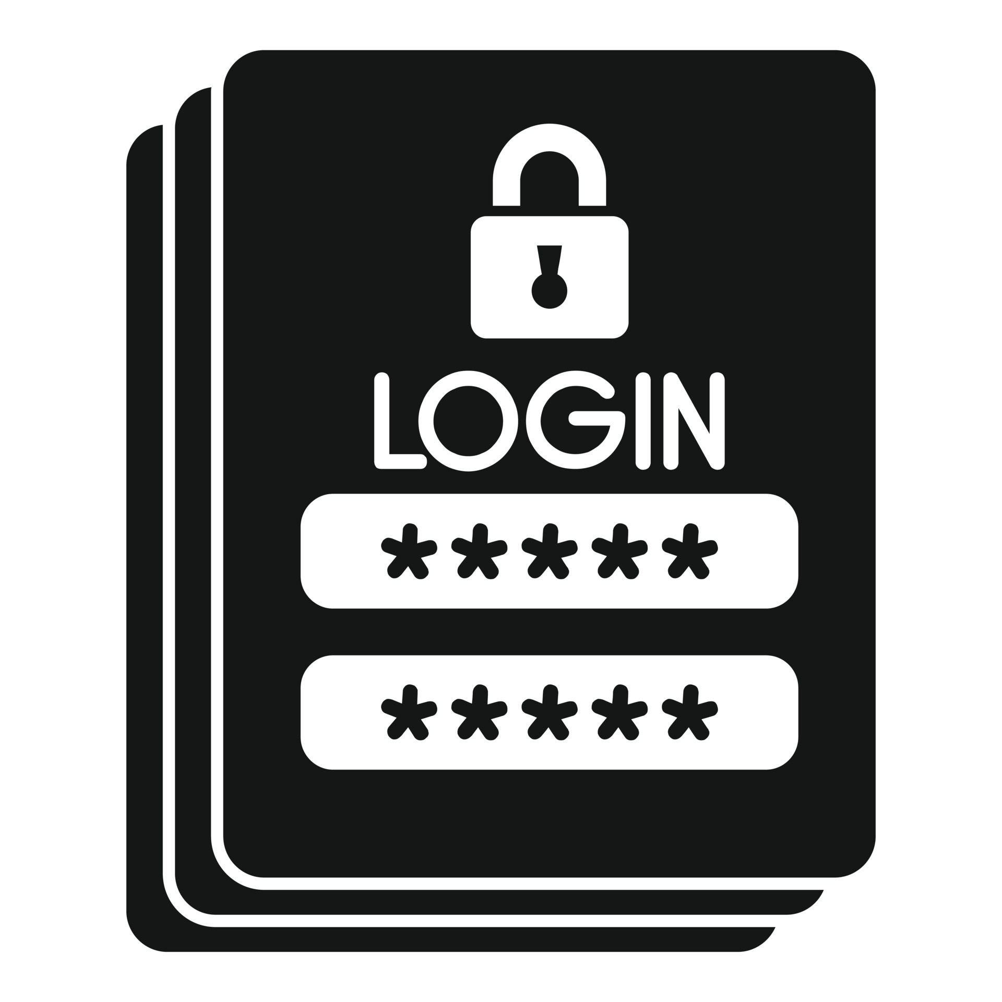
Password protection
Why is it important?
Prevents unauthorised access - strong passwords make it significantly harder for attackers to gain entry.
Protects Personal and Organisational Data – this includes financial data, personal information, etc.
Maintains privacy and confidentiality.
Prevents identity theft.
Mitigates cybersecurity risks.
Complies with regulations and standards.
Notes:
Password Protection
Why is it important?
Prevents unauthorised access - strong passwords make it significantly harder for attackers to gain entry.
Protects Personal and Organisational Data – this includes financial data, personal information, etc.
Maintains privacy and confidentiality.
Prevents identity theft.
Mitigates cybersecurity risks.
Complies with regulations and standards.
Overall, password protection is essential for safeguarding digital assets, maintaining privacy and confidentiality, and reducing the risk of cybersecurity threats and data breaches. By implementing strong password security measures, individuals and organisations can enhance their overall cybersecurity and protect themselves against evolving threats in the digital landscape.
Password Protection Top Tips – In your group you may want to….
Emphasise the importance of not sharing passwords with others or writing them down where they can be easily seen.
Create guidelines for stronger passwords such as having a minimum length or a complex password that includes a mix of lower and uppercase letter, numbers, and special characters.
Avoid using common phrases and words.
Require committee members to regular update their passwords and avoid reusing passwords.

Slide 21
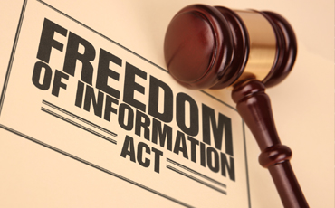
Freedom of Information Act
What is it?
The Freedom of Information Act (FOIA) lets members of the public ask to see information held by public authorities such as schools, councils and healthcare providers. It also means public authorities must publish some information about what they do.
Notes:
What is it?
The Freedom of Information Act (FOIA) lets members of the public ask to see information held by public authorities such as schools, councils and healthcare providers. It also means public authorities must publish some information about what they do.
The good news – This act does not apply to charities, therefore if you get a request, you do not have to comply with it and can politely decline the request.

Slide 22
Top Tips
Do
Lock your computer when leaving it unattended.
Change your password when prompted.
Contact your Group Data Manager if you have any questions.
Dispose of confidential waste in the correct way.
Don't
Share your password with anyone.
Allow anyone to use your computer without your supervision.
Discuss personal/confidential information in a public place.
Send personal identifiable information to a personal email address.
Notes:
Do
Lock your computer when leaving it unattended.
Change your password when prompted.
Contact your Group Data Manager if you have any questions.
Dispose of confidential waste in the correct way.
Don't
Share your password with anyone.
Allow anyone to use your computer without your supervision.
Discuss personal/confidential information in a public place.
Send personal identifiable information to a personal email address.

Slide 23
What we expect of You
Be a ‘compliance champion’ who encourages good compliance within all group processes.
Communicate guidance on data management protocols such as ‘what to do if you suspect a data breach?’, etc.
Raise any poor compliance behaviour to Group Chairs.
Have a look at the ICOs website for all information on UK GDPR.

Slide 24
What Next
Cascade this information to your Groups.
Review your Group’s data management and compliance policies and processes.
Implement a policy or process if there is not one in place.
Consider wider training and/or webinars for Group committee members.

Slide 25
Quiz
A record of processing is a legal requirement to document how we process the data we hold. This allows us to….
- Ensure our records remain up to date and accurate
- Make necessary improvements to comply with data protection law
- Take stock of what information you hold and where you store it.
- All the above
2. There are only 72 hours between becoming aware of a data breach and being required to notify the regulatory authority should there be a risk to the rights and freedoms of an individual. Julie suspects there has been a data breach, she is unsure and doesn’t have all the information. Should she still escalate this to the Group Data Manager?
- Yes
- No
3. Do you require a lawful basis to obtain and process and individuals’ personal data?
- Yes
- No

Slide 26
Quiz
4. Processing is an umbrella term for:
- Collecting and storing data
- Using and sharing data
- Viewing and deleting data
- All the above
5. What is a Data Subject?
- Something in Maths
- Something to do with Accounting
- All living, breathing individuals who reside in the UK/EU.
6. Which email example would not be classed as personal and carries less risk?
- chloe.charlton@iam.org.uk
- feedback@iam.org.uk
- elvis@presley.com

Slide 27
Links
Right to Access - https://ico.org.uk/for-organisations/uk-gdpr-guidance-and-resources/individual-rights/individual-rights/right-of-access/
Right to rectification – https://ico.org.uk/for-organisations/uk-gdpr-guidance-and-resources/individual-rights/individual-rights/right-to-rectification/
Right to erasure - https://ico.org.uk/for-organisations/uk-gdpr-guidance-and-resources/individual-rights/individual-rights/right-to-erasure/
Right to data portability - https://ico.org.uk/for-organisations/uk-gdpr-guidance-and-resources/individual-rights/individual-rights/right-to-data-portability/
ICO Registration - https://ico.org.uk/for-organisations/data-protection-fee/register/
Data Breaches - https://ico.org.uk/for-organisations/report-a-breach/personal-data-breach/personal-data-breaches-a-guide/#whatisa

