Slide 1
Equality, Diversity & Inclusion Awareness Session

Slide 2
Contents
Introduction
Equality, Diversity & Inclusion
Benefits of Equality, Diversion & Inclusion
Equality Act 2010
Protected Characteristics
Defining Disability
Discrimination
Definition
Types of Discrimination
Unacceptable Behaviours
Harassment
Victimisation
Banter
Stereotypes & Prejudice
Consequences
What We Expect of You
What Next
Quiz
Notes:
This topic should really be a one-day workshop – lots to go through in one hour.

Slide 3
Introduction
We live and operate in an increasingly diverse world and equality diversity and inclusion is a moral and legal imperative that concerns us all.
Equality, diversity and inclusion ensures fair treatment and opportunity for all.
It’s about creating an environment and culture where every individual can feel safe with a sense of belonging.
The main benefits of embracing equality, diversity and inclusion are membership recruitment and retention and enhanced reputation.
By the end of this session, you will have gained the following:
an understanding of what the terms ‘equality’, ‘diversity’ and ‘inclusion’ mean
identify ways that people are different
an awareness of your own personal assumptions and attitudes
an understanding of the different types of discrimination
an understanding of harassment and victimisation
recognition of the consequences of not taking equality, diversity and inclusion seriously

Slide 4
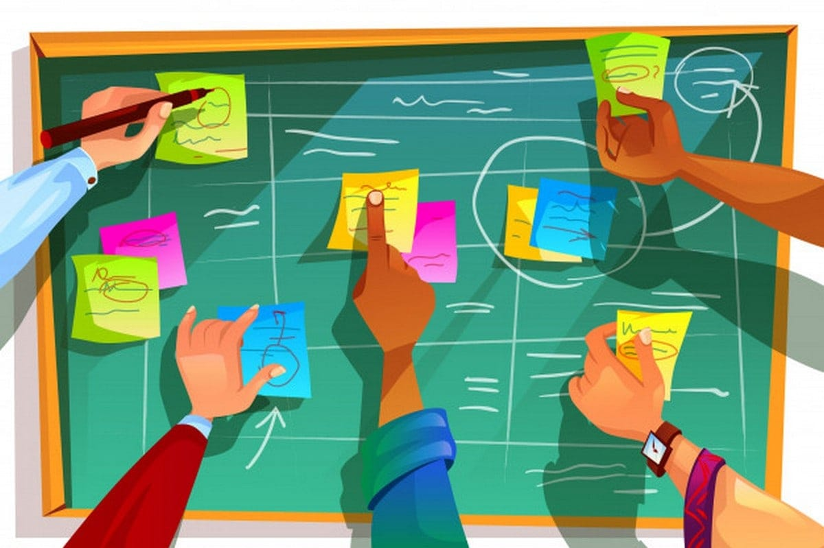
Activity
Take a couple of minutes to think about the definition of the terms:
Equality
Diversity
Inclusion
Put your thoughts into the ‘chat’

Slide 5
Equality
Equality is ensuring individuals or groups of individuals are treated fairly and equally and no less favourably because of differences.
Some differences are protected by law, others are not but it is important to embrace all differences.

Slide 6
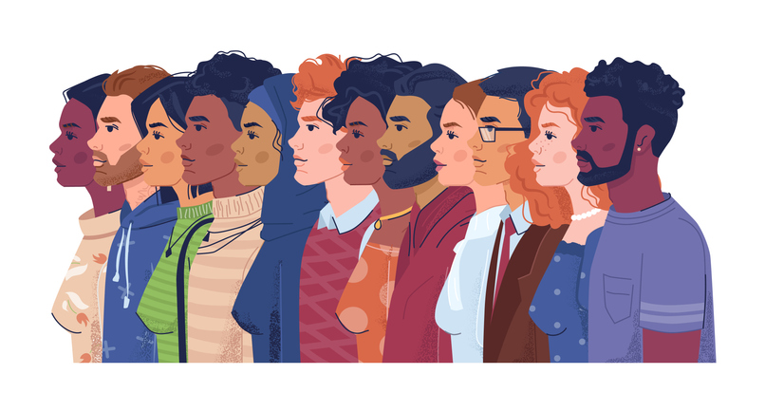
Diversity
Diversity is about valuing the range and differences of people in your group.
Every individual is unique, and we need to acknowledge and value their individual differences.

Slide 7
Inclusion
Inclusion is a sense of belonging.
Inclusion aims to recognise, respect and value people’s differences to contribute and realise their full potential by feeling involved and part of a group.
To summarise, inclusivity lets people feel safe to:
Put forward new and different ideas
Raise issues and suggestions and knowing that this is encouraged
Try doing things differently to how they’ve been done before
Give their best and contributing to success

Slide 8
Benefits of Equality, Diversity & Inclusion
Legal compliance
Everyone has the same access to resources and opportunities
New and broad ways of thinking – avoids ‘group think’
Enhanced brand and reputation
Attracting the best volunteers (and members)
Engaged, committed and retained volunteers and members
Positive performance (creativity, problem solving and decision making)
Notes:
All are important but key benefits are legal compliance, reputation and attracting the best volunteers

Slide 9
Equality Act 2010
The Equality Act came into force on 1st October 2010 bringing together over 116 separate pieces of legislation into one single act.
Combined, they make up an act that provides a legal framework to protect the rights of individuals and advance equality of opportunity for all.
Under the Equality Act you are protected from discrimination:
when you are in the workplace
when you use public services like healthcare (for example, visiting your doctor or local hospital) or education (for example, at your school or college)
when you use businesses and other organisations that provide services and goods (like shops, restaurants, and cinemas)
when you use public transport
when you join a club or association (for example, your local IAM group)
when you have contact with public bodies like your local council or government departments

Slide 10
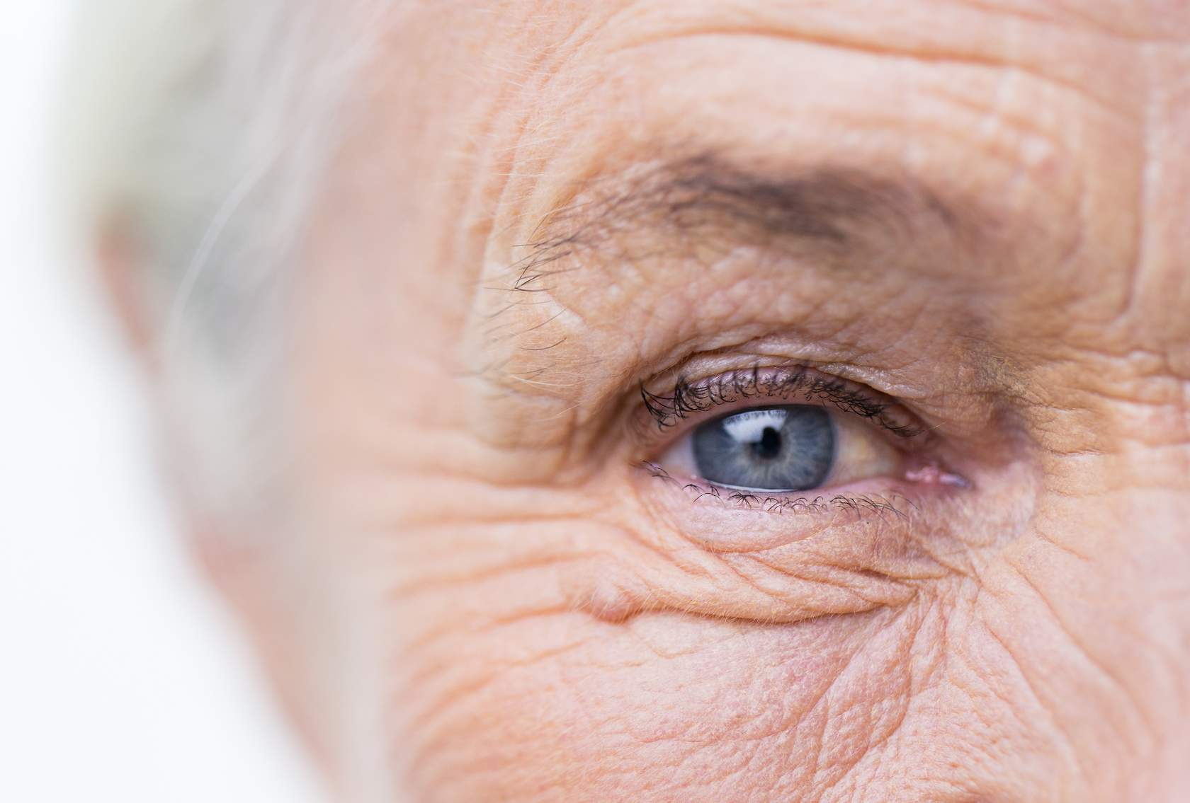
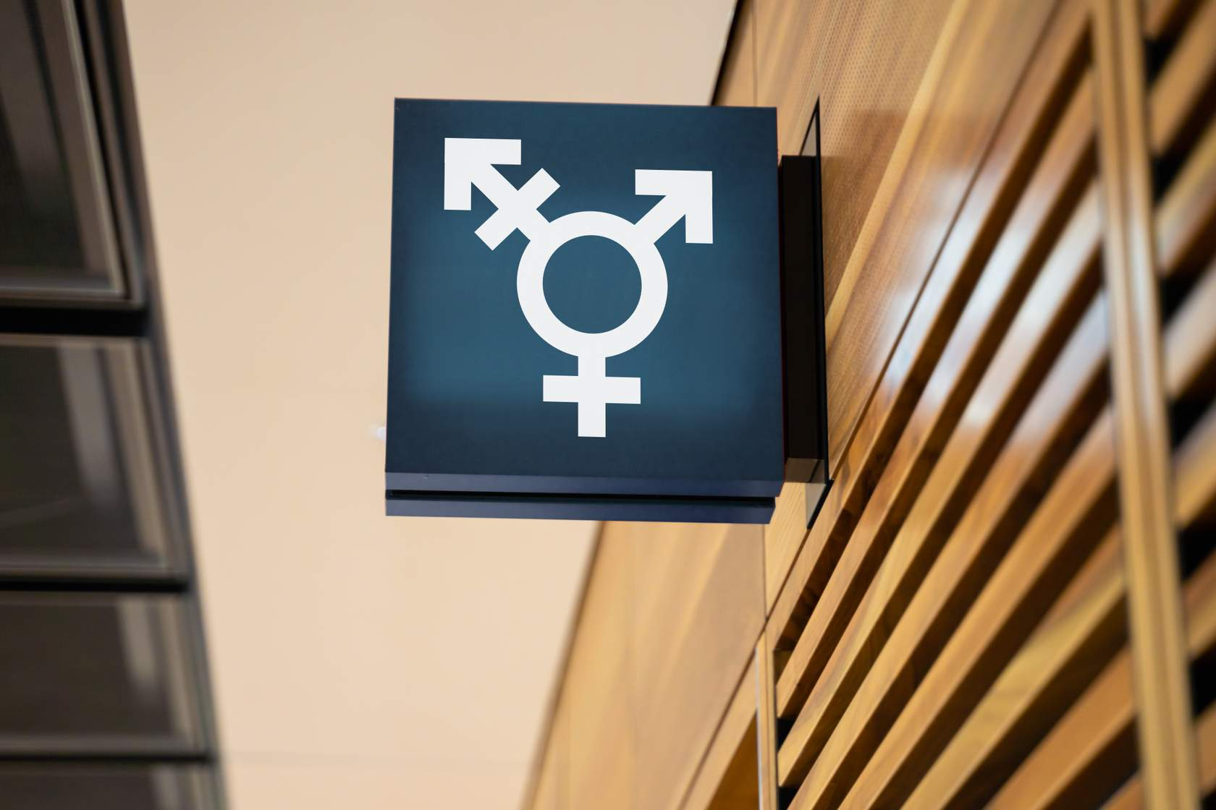
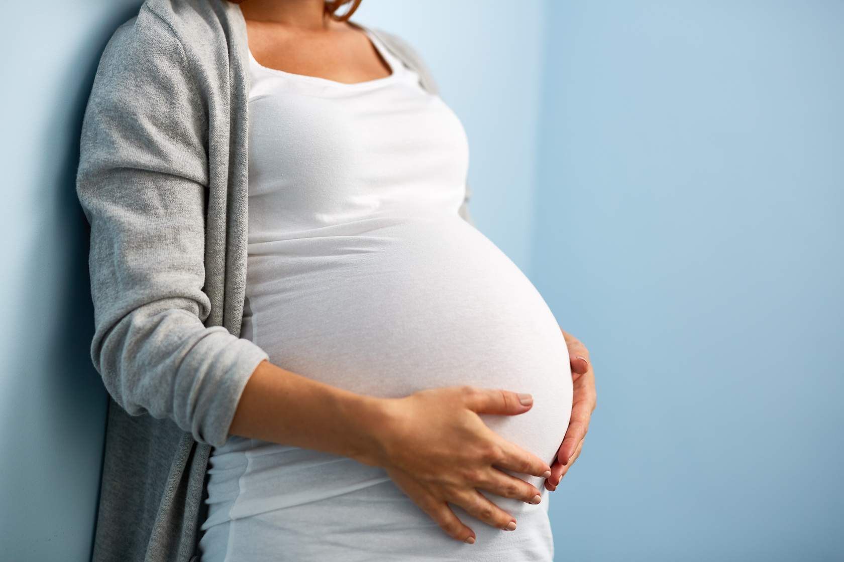
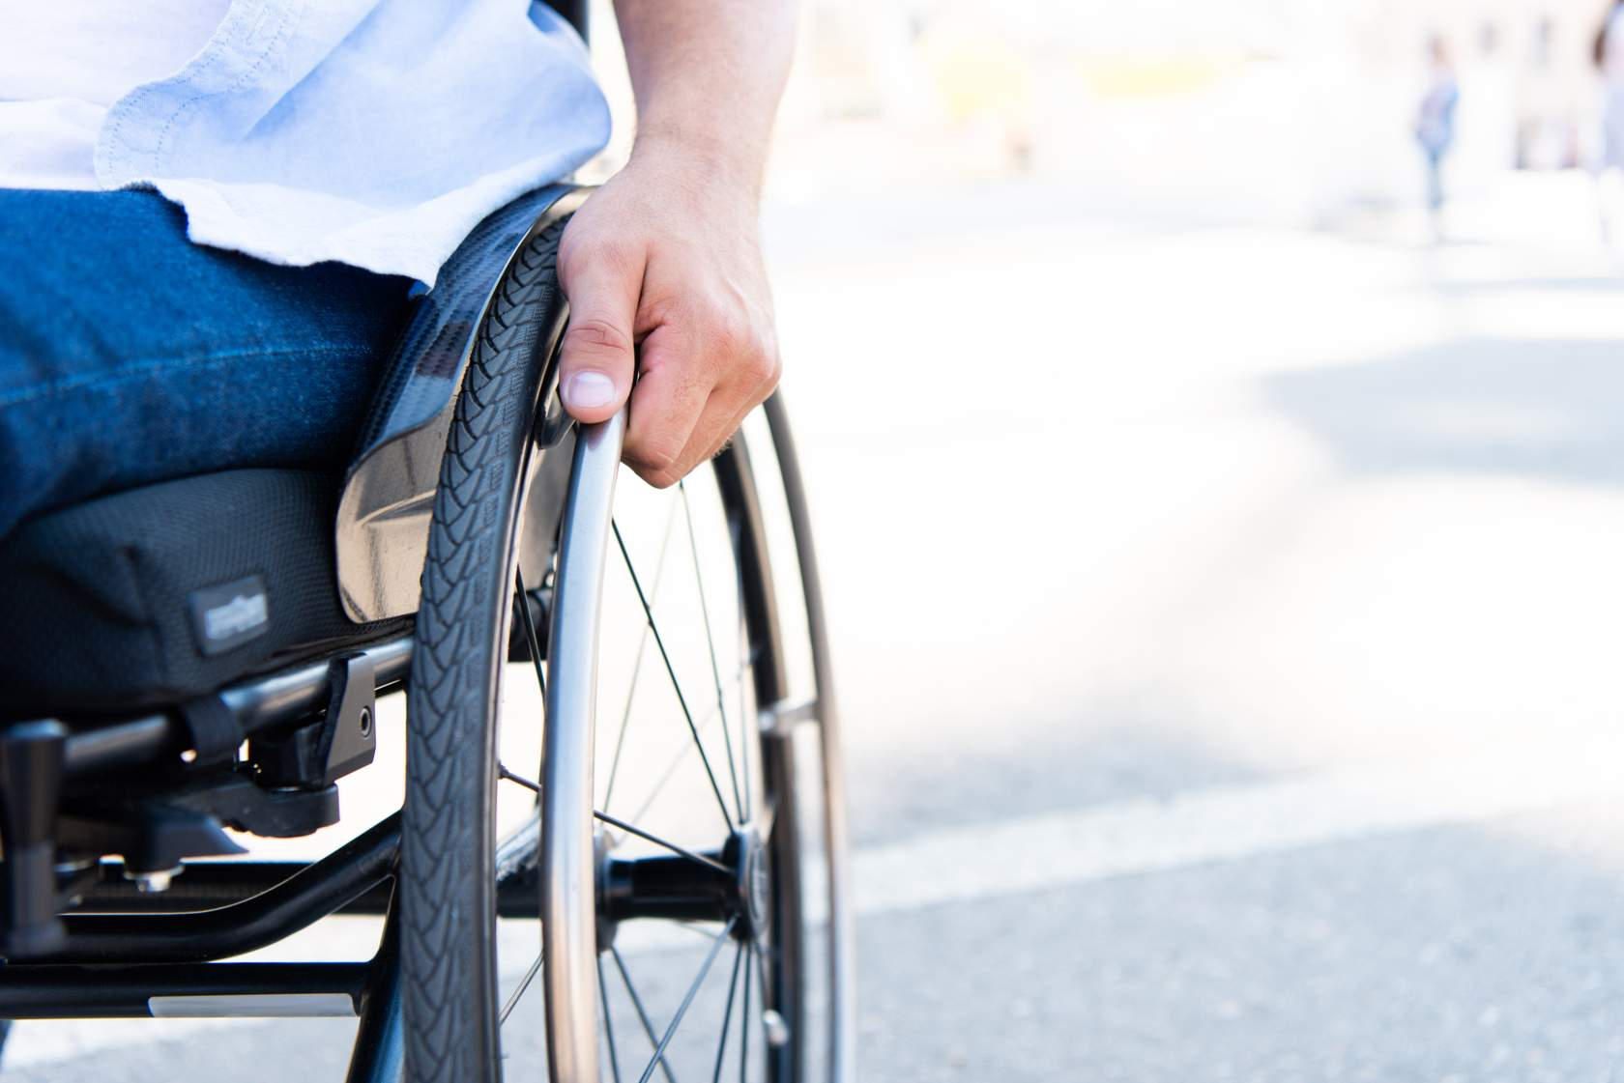
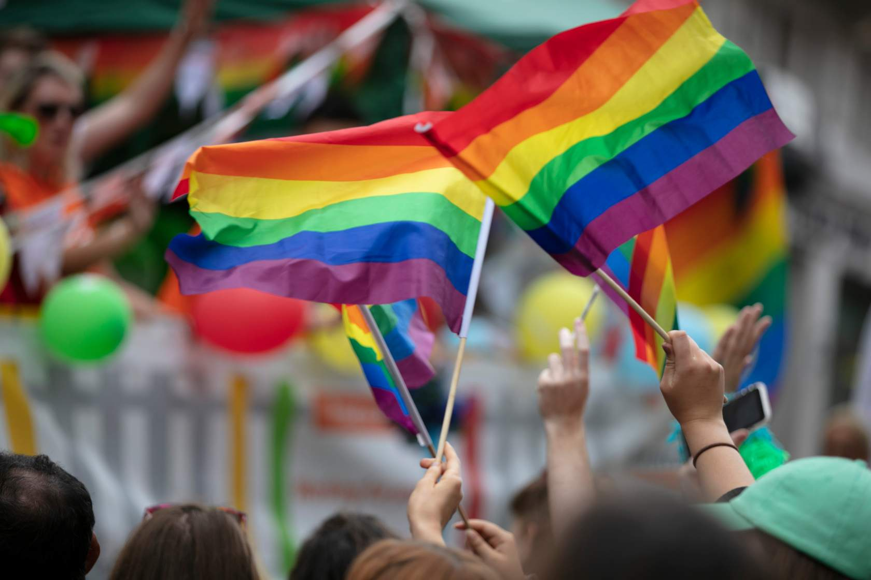
Activity
There are 9 protected characteristics named within the Equality Act, can you name them?

Slide 11
Protected Characteristics
Age
Gender reassignment
Being married or in a civil partnership
Pregnancy/maternity
Disability
Race (including colour, nationality or ethnicity)
Religion or belief
Sex
Sexual orientation

Slide 12
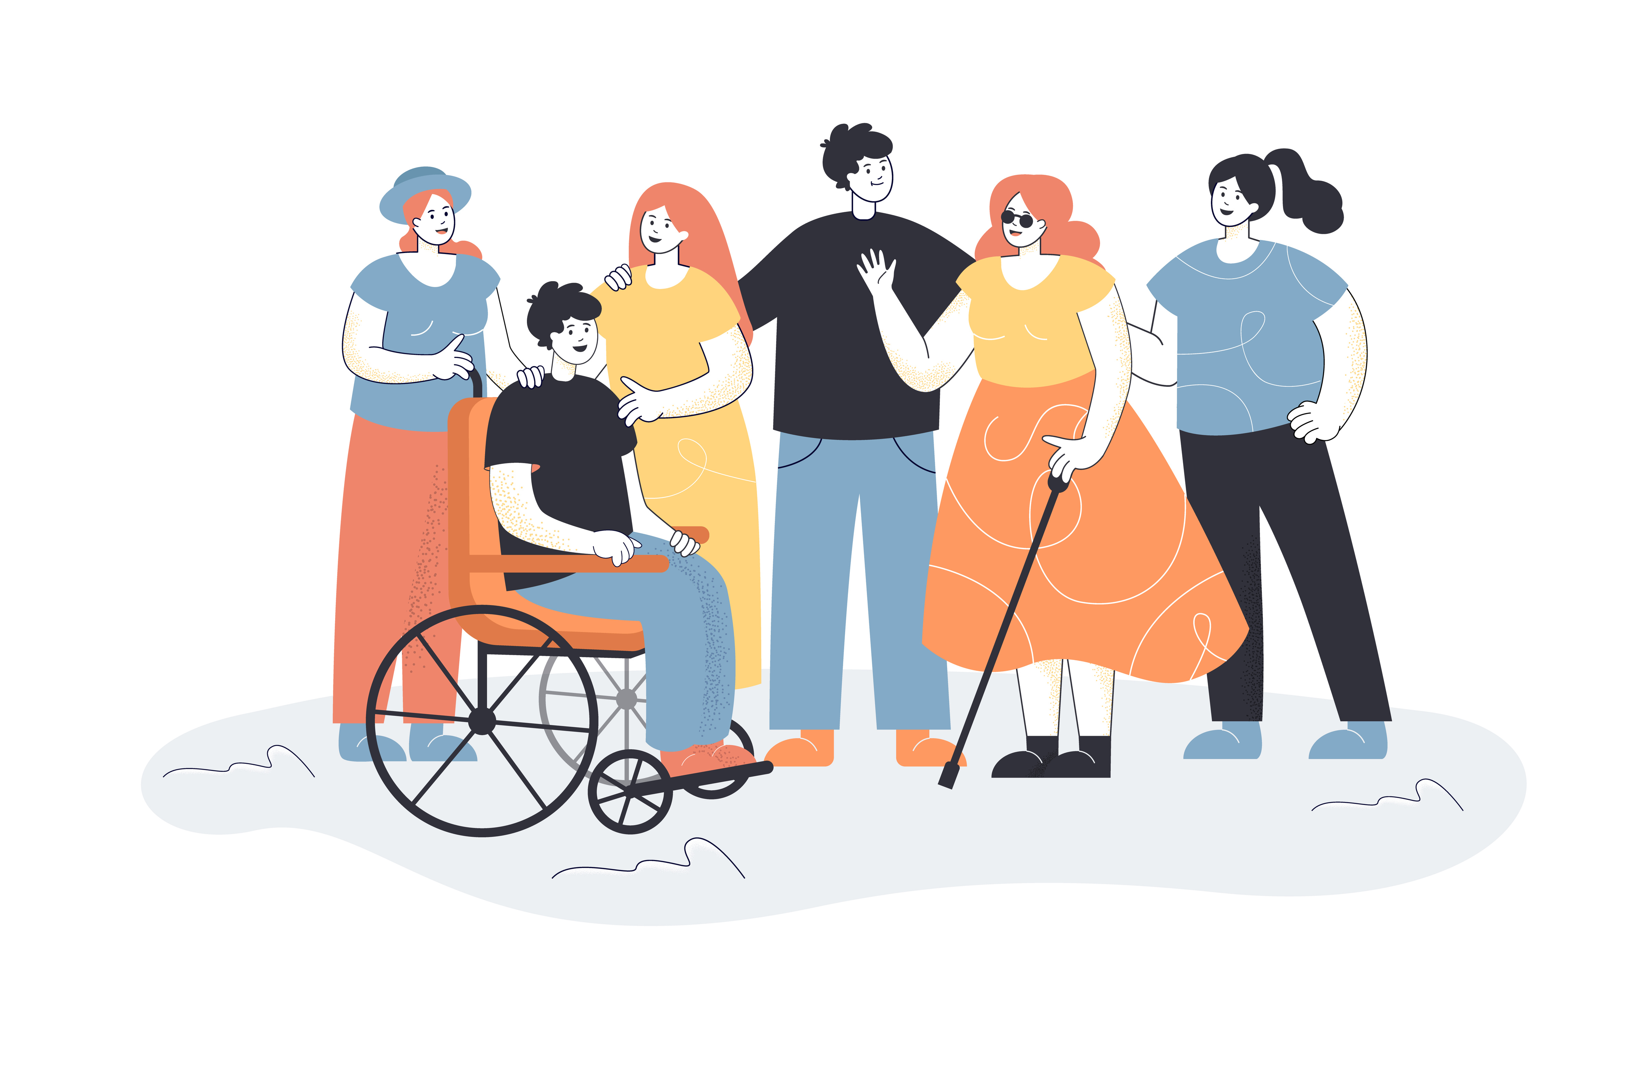
Defining Disability
The definition of disability in the Equality Act 2010 is:
Someone with a physical or mental impairment which has a substantial or long-term adverse impact on their ability to carry out normal day to day activities.
There are some disabilities you can see and others you can’t – examples or those you can see (wheelchair use, diseases in advanced stages eg: MND, MS)
Can you give an example of ‘hidden’ disabilities?
Notes:
Hidden – neurodiverse disorders such as aspergers and autism

Slide 13
Defining Discrimination
Defining Discrimination:
Discrimination is when a person is treated unfairly or badly because of something about them
Types Of Discrimination
There are four different types of discrimination:
Direct discrimination
Indirect discrimination
Associative discrimination
Perceptive discrimination

Slide 14
Types of Discrimination 1/2
There are four different types of discrimination:
Direct Discrimination
This is when a person is treated less favourably than another person in the same circumstances.
Can you give an example of this?
Indirect Discrimination
This happens when a requirement is applied equally to everyone but has the effect of excluding one group of people more than another.
Can you give an example of this?
Notes:
Direct – preferring a man on the group committee to a woman
Indirect – holding group meetings only on Sat/Sun – religious beliefs

Slide 15
Types of Discrimination 2/2
Associative Discrimination
Associative discrimination happens when someone is treated less favourably because of someone else’s protected characteristic.
For example:
A person isn’t given an opportunity within their group because they have a disabled child, and it is believed they can’t attend meetings in the evenings and may be unavailable as they need to care for their child.
Perceptive Discrimination
Discrimination against an individual because of a perception that they have a protected characteristic when they do not, in fact, have that protected characteristic.
For example:
Assuming someone's sexuality because of the way they look/talk/act.

Slide 16
Unacceptable Behaviours
Unacceptable behaviour is unpleasant and unwanted in any situation
It could be classed as ‘discrimination’ if the focus is on ‘difference’
There are 2 types of unacceptable behaviours:
Harassment
Victimisation
Harassment and victimisation are considered as equality and diversity issues
Bullying is not included in equality, diversity and inclusion, although it is unacceptable and unwanted!
Notes:
There is not currently any specific legislation on ‘bullying’, it currently focuses on ‘harassment’ – usually have Bullying & Harassment policy.

Slide 17
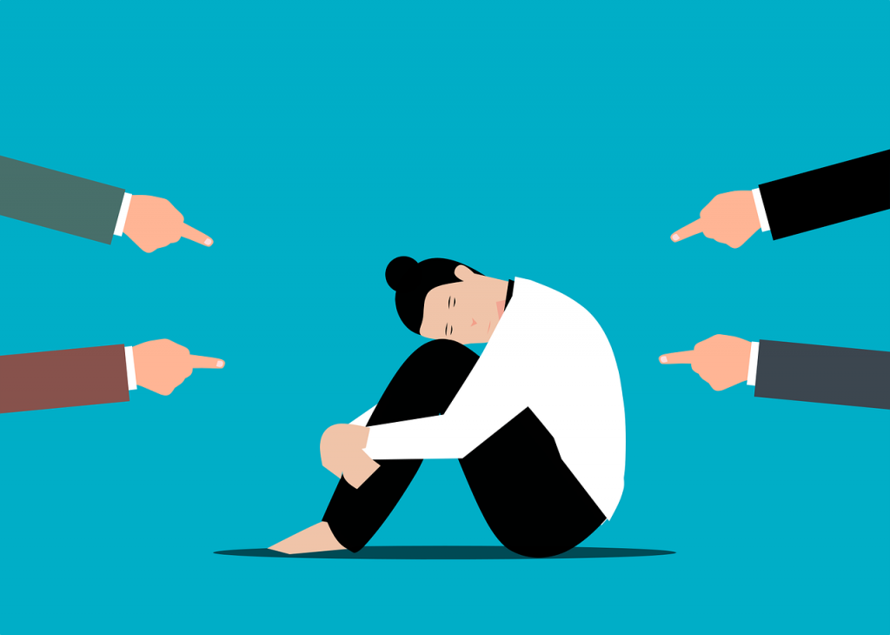
Harassment
Harassment is defined as "unwanted conduct relating to a relevant protected characteristic.”
Violates a person's dignity
Makes a person feel intimidated, degraded or humiliated
Creates a hostile or offensive environment
Mode of Harassment
Spoken or written
E-mails, tweets or comments on social networking sites
and websites
WhatsApp
Images and graffiti
Physical gestures
Facial expressions
Jokes
Third Party Harassment
Group Officials could be liable for third-party harassment if they “unreasonably fail to take appropriate corrective action that could prevent the misconduct from recurring".
A third party could include a client, customer, supplier, visitor, representative, ambassador, member, contractor, service user etc.

Slide 18
Victimisation
Victimisation happens when an individual is singled out because they have raised a complaint or challenged treatment they have received.
Examples could include:
Removing someone who has made a sex discrimination complaint against the group
Not enabling someone to join the committee as they have accused a fellow group member of discrimination due to a disability
Behaving in a hostile manner to someone who has supported a fellow group member in submitting a formal complaint of racist behaviour

Slide 19
Banter
What is banter?
Banter is the playful and friendly exchange of teasing remarks.
Banter can be a high-spirited exchange between friends and colleagues BUT….
it could be taken out of context by the other person or a third party.
Here are some examples of banter:
Calling someone who dislikes football ‘gay’
Telling a female colleague, she ‘looks good in leathers’
Telling an inappropriate joke eg: Irish and stupidity
All of the above focus on a ‘protected’ characteristic, but this is not always the case…
Referring to someone with red hair as ‘ginger’, ‘carrot top’
What one person finds funny, another may not! treat others with the respect you would want to be treated with.
Advice is – if unsure don’t do it!

Slide 20
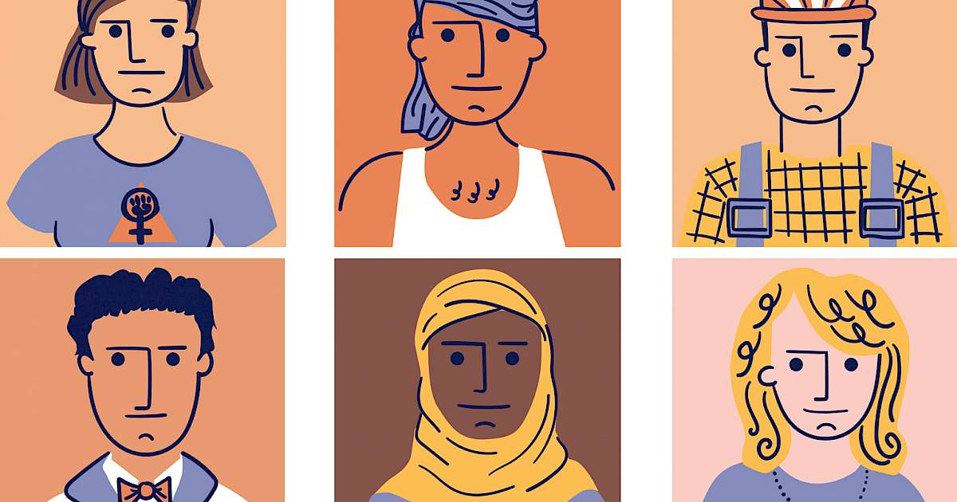
Stereotypes & Prejudices
We often make assumptions about other people, about their abilities, skills and qualities without knowing the facts. This can sometimes be ‘unconscious bias’.
What we see:
Appearance
Gender
Skin colour
Age
What we don't see:
Values / beliefs / experiences / history
Sexual orientation
Religion / faith
Non-visible disabilities
Protected characteristics are not always obvious, so it is important not to make assumptions about people or their abilities.

Slide 21
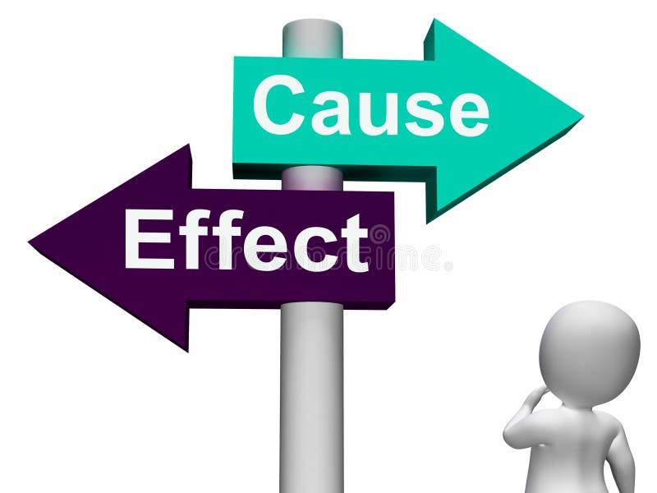
Consequences
There are potential consequences of not embracing equality, diversity and inclusion that fall under two headlines:
Reputation and Financial
Bad publicity
Legal proceedings
High tension, low commitment = members and volunteers leaving
Low energy and a lack of innovation and voice
Loss of talented people
The consequences could prove to be very costly!

Slide 22
What we Expect of You
Be a ‘diversity champion’ who welcomes all and who others can comfortably express concerns to and elicit support and guidance from.
Be welcoming respectful to all and accept ideas that are different from your own.
Treat people in the way they want to be treated rather than the way you want to be treated.
Call out others who don’t yet appreciate the value of diversity or who may not always behave respectfully.
Poor behaviour can come from ignorance, or lack of knowledge and experience
Be willing to learn, accept feedback, and listen to the concerns of those around you.
Take time to learn about different cultures, races, religions, and backgrounds. Ask others to share some of the customs and practices associated with their cultures.
Notes:
Lead by example, support and guide others

Slide 23
What Next
Cascade this information to your Groups
Review your Group’s policy and processes on dealing with discrimination, harassment and victimisation
Implement a policy or process if there is not one in place
Review your website, Facebook account and WhatsApp group
Consider wider training and/or webinars for Group members

Slide 24
Quiz
1. True or false, banter could be taken out of context by another person? (True)
2. Which of the below are types of discrimination? (All)
Associative discrimination
Perceptive discrimination
Victimisation
Direct discrimination
3. What type of discrimination occurs when one person is treated less favourably than another in comparable circumstances?
Direct discrimination
Harassment
Victimisation
Indirect discrimination
4. Which of the following is not a protected characteristic?
Age
Gender reassignment
Sex
Hair colour
Disability
Race
5. Which of the following can be classed as unwanted behaviour? (All)
Offensive emails
Jokes
Physical gestures
Verbal abuse

